Slide 1
Disease
Disease is any condition that prevents the body working as it should. As a result, the body may fail to maintain homeostasis.

Slide 2
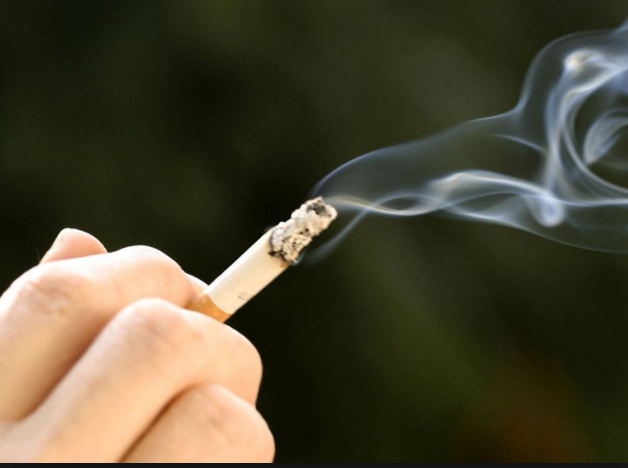
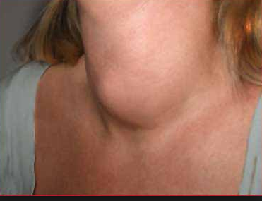
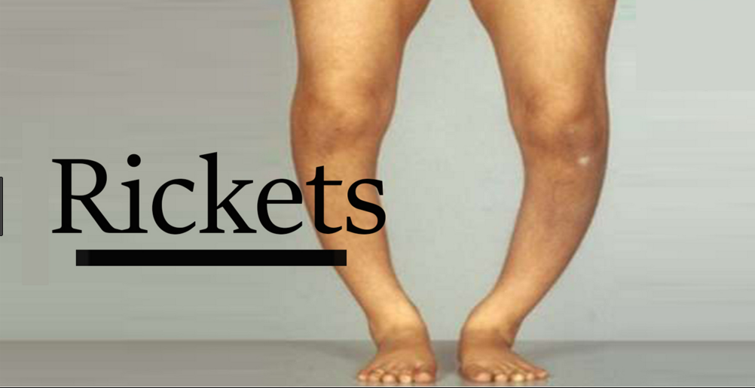
Causes of Disease
Inherited disorders: Sickle cell disease
Exposure to toxins: lead poisoning
Poor nutrition: goiter, scurvy
Organ malfunction: heart attack
High Risk Behavior: lung cancer, skin cancer

Slide 3
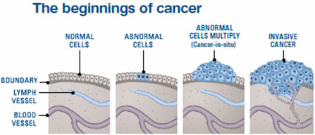
Cancer
Uncontrolled cell division: may be caused by genetic mutations in a cell or because of radiation or chemical exposure.

Slide 4
A little vocab
Pathogen: disease causing organism (bacteria, viruses, fungi, parasites)
Antigen: a molecule that the immune system recognizes as “self” or “invader.”
Antibody: protein made in response to an antigen (specific….measles antibodies do NOT protect a person from chicken pox.)
Immunity: a person’s ability to destroy pathogens

Slide 5
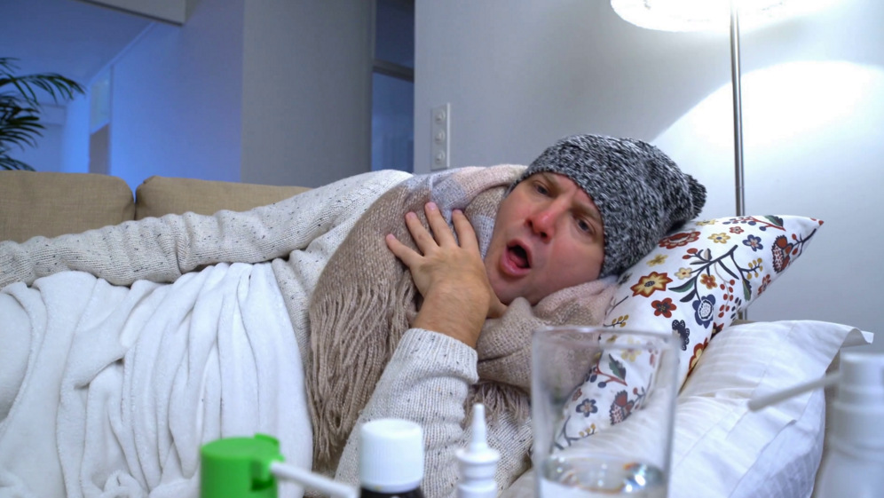
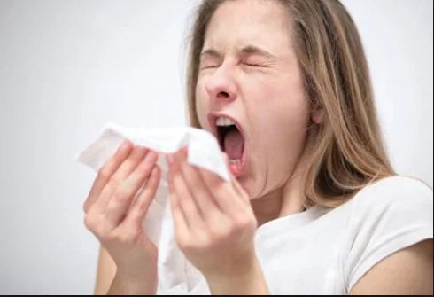
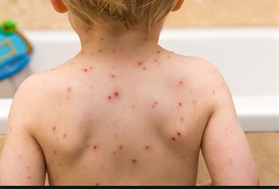
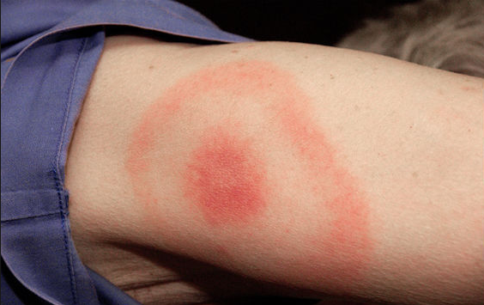
Examples
Viruses: colds, flu, chicken pox, AIDS
Bacteria: strep, food poisoning, Lyme disease
Fungi: athlete’s foot, ringworm
Parasites: tapeworms, leeches, heartworm

Slide 6
Preventing Disease
First line of defense: skin and mucous membranes, tears and saliva

Slide 11
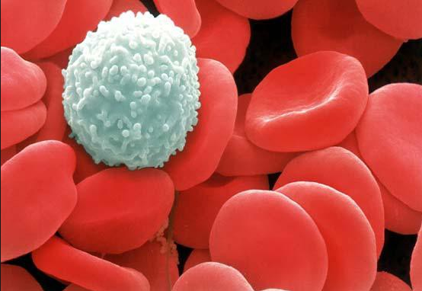
Blood
Components are white blood cells, red blood cells, platelets. All are in a fluid called plasma.

Slide 12
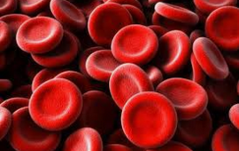
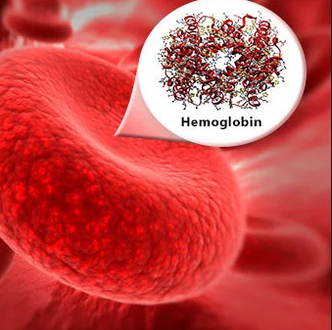
Red Blood Cells
Carry oxygen to body cells with hemoglobin (iron-containing pigment)

Slide 13
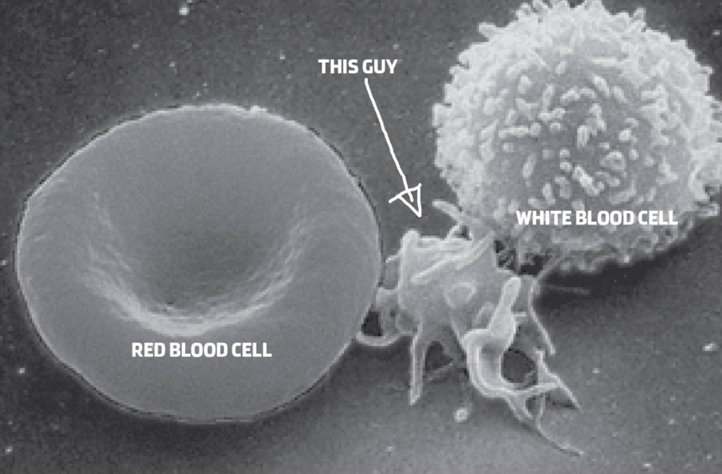
Platelets
Assist in blood clotting

Slide 14
White Blood Cells

Slide 15
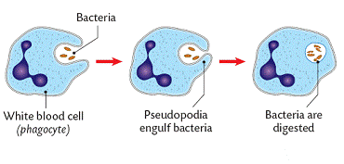
Phagocytosis

Slide 17
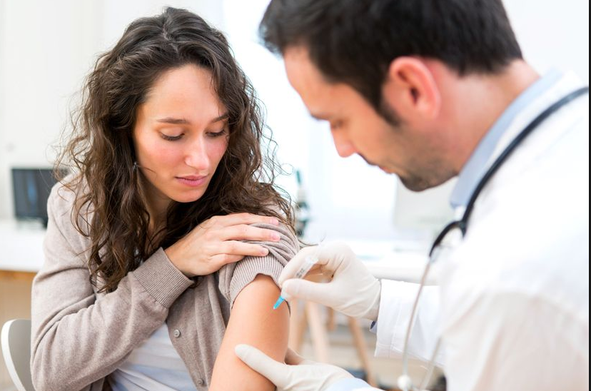
Vaccines

Slide 19
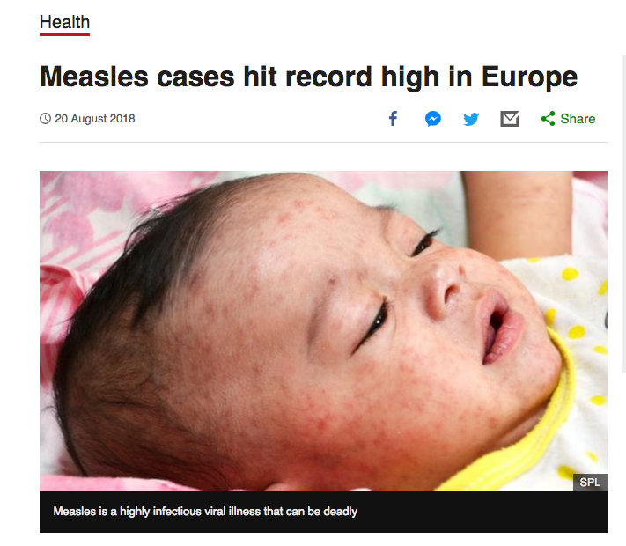
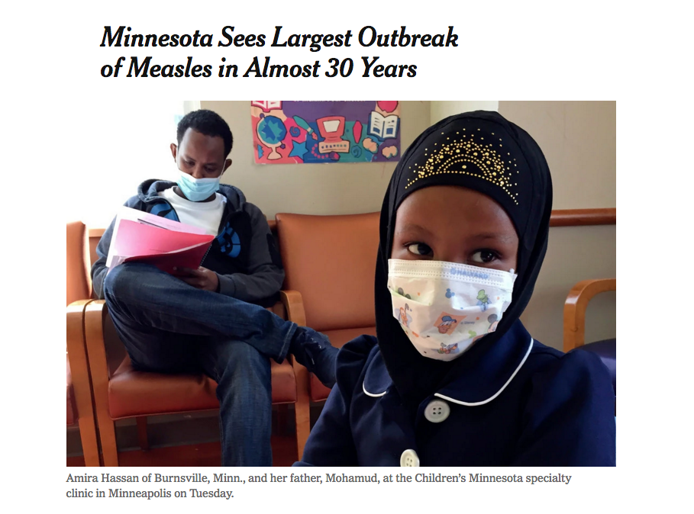

Slide 20
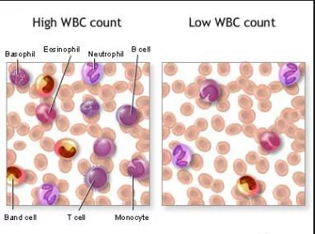
While fighting an infection…
White blood cell numbers increase

Slide 21
Damage to the Immune System
Stress
Fatigue
AIDS: the virus hijacks the immune system. People with AIDS often die of infections someone with a normal immune system would fight off.

Slide 22
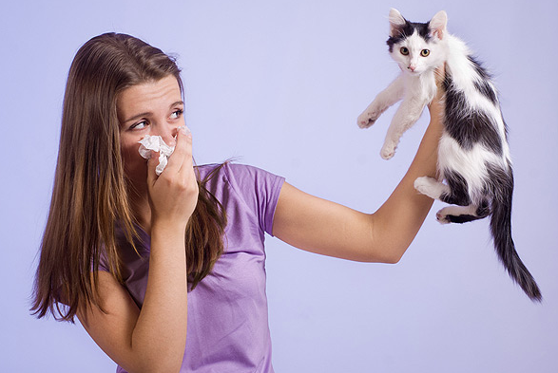
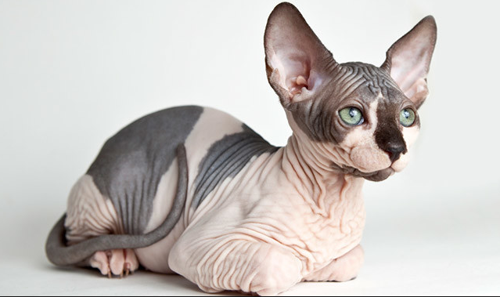
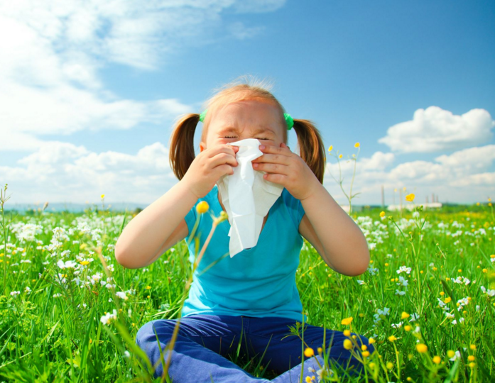
Allergies
The body’s response to a normally harmless antigen.

Slide 24
Making Connections….our next State lab.
Body systems do not work in isolation…..body systems work together to maintain homeostasis.
Ex. Respiratory and Circulatory (respiratory brings in O_{2,} circulatory brings it to all cells of the body.
Ex. Digestive and Circulatory (Digestive breaks down organic compounds into usable molecules; circulatory system delivers those compounds to body cells.

