Slide 1
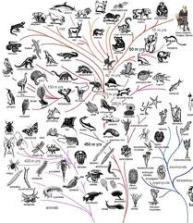
Evolution

Slide 2
Overview
Life on earth began more than 3 billion years ago
Fossils have given us many clues to the kind of life that was around 3 billion years ago
The first organisms were simple, single-celled organisms
More complex creatures began to appear
The idea that attempts to explain this change = evolution

Slide 3
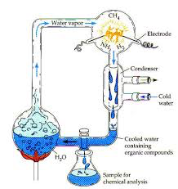
Origins of Life
Formation of the Earth
Big Bang Theory
Gases condensing
Plants forming
Water vapor was in the atmosphere
Temperatures cool
Water vapor condenses and rain falls
Oceans formed

Slide 4
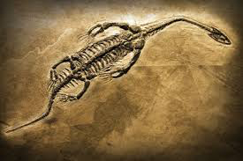
Life on Earth
The tale of life on earth is told through fossils
Fossils form through:
Organisms dies
It is buried
Organic material is dissolved and lost
Space fills in with mineral deposits

Slide 5
How Life Develops
4 major developments
Simple organic compounds important to life must have formed (amino acids)
Formation of complex organic compounds (proteins)
Concentration of the compounds
Development of links between chemical reactions of growth, metabolism, and reproduction
Can no longer occur because we have oxygen

Slide 6
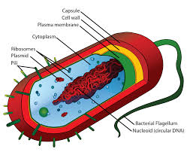
First Life Forms
The first life forms are thought to be prokaryotes
These first life forms probably:
Had to get food from their surroundings
Used the food through glycolysis or similar process
Were heterotrophs
Through competition for food autotrophs developed

Slide 7
First Life Forms
Chemosynthesis, rather than photosynthesis occurred first
Then photosynthesis
Then photosynthetic organisms that produced oxygen as a waste product
Oxygen destroyed many enzymes – but gave rise to aerobic respiration
Aerobic respiration results from reactions used to trap free oxygen

Slide 8
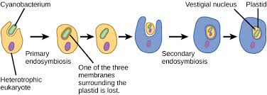
Theory of Eukaryotes
Theory are not set in stone but are educated guesses and ideas backed by research and evidence
Endosymbiosis – mitochondria and chloroplasts are through to have entered eukaryotes for protection and happened to perform a function within them

Slide 9
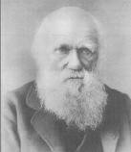
The Theory of Evolution
The central theme for modern biology
Helps us understand how the variations among individuals leads to changes in an entire species
Charles Darwin = first suggested the idea
Since then more evidence has been collected
It is now considered a theory
Theory = concept that has been tested and confirmed in many ways and can be used in predictions
https://www.youtube.com/watch?v=92oHNd8vFwo&list=PL8dPuuaLjXtMczXZUmjb3mZSU1Roxnrey&index=5

Slide 10
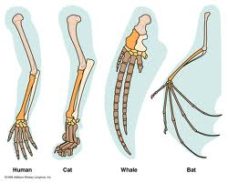
The Theory of Evolution
Helps biologists understand the similarities among organisms
Similarities in bone structure or biochemistry
Helps to explain the history of life
Based on:
Fossil record
Common ancestry
Homologous structures
Vestigial structures

Slide 11
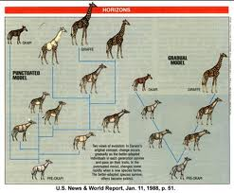
Fossil Record
Fossil record = collection of fossils providing clues to the history of earth and its organisms
Fossil record spans much of geologic time
billions of years in earth’s history
Fossils lower in the ground are from older organisms
Younger fossils are on the top

Slide 12
Fossil Record
Scientists can determine that a fossil is a certain age or older than another based on:
Position in sediment – lower ones are older
Carbon dating using isotopes Carbon-14
C-14 is unstable and breaks down over time into Carbon-12 which is stable and more common
By comparing the amount of C-14 and C-12 we can estimate an age of the fossil.
https://www.youtube.com/watch?v=phZeE7Att_s

Slide 13
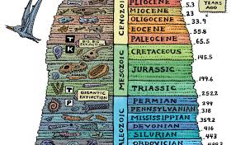

Slide 14
The Theory of Evolution
Evolution does NOT necessarily produce long-term changes in a certain direction
Evolutionary change is more like the growth of a tree
It can branch out in different directions to survive
Some die all together with no branching
Other branches continue to branch out and form new species
https://www.youtube.com/watch?v=UPggkvB9_dc

Slide 15
Evolutionary Changes
These changes over time are represented through phylogenic trees
They show common ancestry and what species are still present today
The bottom is the common ancestor of each
As you move up the tree more species develop
The end of each “branch” shows the most recent species
The branches that are still growing are currently living species
Those that have stopped growing are now extinct

Slide 16
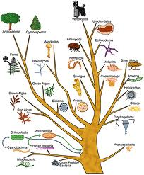

Slide 17
Generation of Life
Spontaneous Generation was a theory believed once
It was the idea that living things come from nonliving things
I resulted from people observing otherwise unexplainable phenomena
Redi- Fly and Meat Experiment
Flies were thought to come from dead meat
Spallanzani – bacteria and broth experiment
Microorganisms were thought to come from the air
Pasteur – cleared up Spallanzani’s experiment and in doing so caused the theory of spontaneous generation to be disproved/disappear
The theory of biogenesis replaced it
Biogenesis is the theory that all living organisms must come from other living organisms

Slide 18
The Mechanisms of Evolution
Darwin didn’t just suggest evolution
He also suggested how they evolved
He thought it was similar to artificial selection that breeders participate in
Artificial selection = purposefully breed organisms for certain traits
He used the idea of “natural selection” to indicate evolution was controlled by nature
Individuals that survive are able to pass on their genes to the next generation
Those that do not survive cannot pass on genes

Slide 19
Overview of Evolution
In any environment, an individual may be born with characteristics that make them stronger, faster, or give it an advantage to being able to reproduce
The individuals that are best adapted to their environment will pass on their traits
Eventually, these useful traits will be more common
Each generation passing it on
Traits that decrease an individuals’ chances of reproducing will decrease

Slide 20
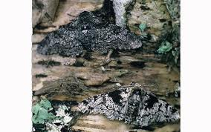
Overview of Evolution
The long term change of natural selection is due to certain traits being passed on and others not being selected
Advantageous traits become more common
As these traits become more common (or less common) = evolution

Slide 21
Overview of Evolution
The population changes over time, not the individuals themselves
Each individual is born with genetic information but it does not change over time
Over time though, the population may change to show more beneficial traits more often
Failure to adapt = death
Extinction – when an entire species fails to survive a change in their environment
No longer exists anywhere on the planet
Extirpation – when a species fails to survive a change in their environment within a geographical location

Slide 22
Interactions and Evolution
Evolution is powered by interactions between the environment and organisms
Conditions that make evolution a vital process =
Overproduction=population to increase in size
Finite (limited) resources
Genetic differences in offspring due to mutation and genetic “shuffling”
The selection of offspring better able to survive and reproduce

Slide 23
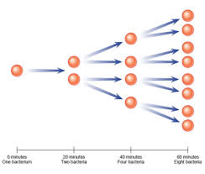
Overproduction
A species has the potential to produce more offspring can could possibly survive.
Species that reproduce quickly =
Bacteria, insects, dandelions, rabbits
If all the offspring of these species survived the earth would be overrun

Slide 24
Overproduction
The population of a species remains about the same form one year to the next.
Each year 100 deer may be born but there are still the same amount of deer present as there were the year before.
Not all individuals will survive till the next year/ adulthood

Slide 25
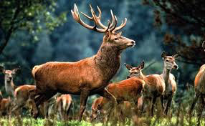
The Struggle for Survival
Overproduction leads to competition among members of a species
Not all members survive long enough to reproduce
To determine which offspring will survive is often left to chance
Example: a deer may be born in a wildlife preserve or it may be born in the path of a wild fire

Slide 26
The Struggle for Survival
There are factors that can help to determine which offspring survive and which will die
Offspring need to be able to survive environmental conditions
Temperature, disease, parasites, predators
Need of resources
Water, food, oxygen, shelter

Slide 27
The Struggle for Survival
Resources are finite
Organisms must compete for the resources
If the organisms is a successful competitor, it will have the resources it needs to survive
Many organisms will not be successful competitors and will perish before they can reproduce

Slide 28
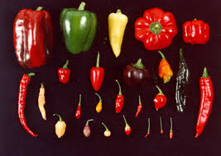
Variation
New traits can lead to evolution within a species
Organisms within a species are never exactly alike
Some grasshoppers have long legs, other short legs
Some butterflies are lighter others are darker
These differences are due to genetic variation
Unique combination of traits from parents

Slide 29
Importance of Change
If all members of a species were exactly alike and an environmental change took place it could be disastrous
By having genetic variations there is a great chance that at least some of the members of the species would survive an environmental change
Endangered species may not have enough genetic variation required to survive even a slight change in their environment

Slide 30
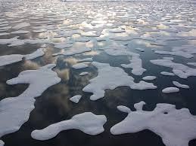
Importance of Change
Change is related to the change in the environment
Minimal environmental change results in stable population
Rapid environmental changes result in rapid changes in the species
Species with high rates of reproduction and short reproduction cycles evolve quicker
Failure to adapt = death

Slide 31
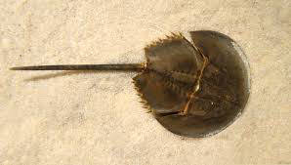
Importance of Change
Rate of Evolution
Stable environments results in stable species
Horseshoe crab
A changing environment results in a changing species
Horse
Bacteria due to antibiotics
Insects due to pesticides

Slide 32
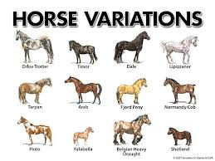
Variation
Some variations give an individual an advantage over another
A trait that helps an organism survive and reproduce under a given set of environmental conditions has “adaptive value”
The ability for a rabbit to blend in with its surroundings will let it escape a fox

Slide 33
Selection by the Environment
As Darwin said with natural selection, an organism with adaptive value have a competitive advantage.
If the beneficial trait is passed on to the offspring, they will be likely to survive and reproduce
The proportion of individuals with this trait will increase as time goes on

Slide 34
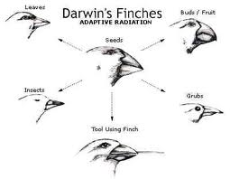
Selection by the Environment
Some evolution may occur without much change in the environment
Most of the time there is an adaptation of the species to changes in the environment
A changing environment leads to evolution

Slide 35
Sources of Variation
The arrangement of DNA bases determines a persons characteristics
Any change in bases or their order can change a characteristic
Only changes in a sex cell can be passed on to the next generation
This is the basis for evolution
Changes in body cells cannot be passed on
Example: a man gets muscles from exercise, his kids do not automatically inherit his muscles

Slide 36
Sources of Variation
There are two major ways an organism can wind up with genes that differ from those of it’s parents
Some are due to mutations in the genes
Others are due to genetic shuffling
Genetic shuffling = sorting and recombining genes during sexual reproduction

Slide 37
Mutation
A mutation is a change in the base pairs of DNA
They are random and cannot be predicted
Some mutations occur as errors in DNA
Radiation and some chemicals can cause mutations
Mutations are an important source of totally new forms of genes

Slide 38
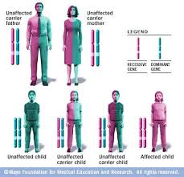
Mutation
When mutations occur in body cells, it only affects that cell
A mutation in a uni-cellular organism or in a sex cell of a multi-cellular organism can be passed on

Slide 39
Mutation
All mutations are harmful and can affect the offspring severely
so that it wouldn’t be able to survive
Some mutations can benefit the individual
Increase it’s chances of surviving, reproducing, and passing the mutation along
This could lead to the creation of a new species
Example: ancestors of polar bears probably had brown fur but white fur was beneficial

Slide 40
Genetic Shuffling
Sorting and random recombining of genes during meiosis and fertilization results in a new and different combination of genes
These genes can be passed on
Example: shuffling a deck of cards: overall the deck stays the same but every hand is different than the one before
Sexual reproduction increases this
now we are shuffling two decks of cards
Mutations are a big source of evolution but genetic shuffling is the main source of variation in sexual reproduction

Slide 41
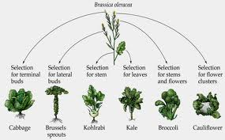
Results of Genetic Variation
Changes from mutations or genetic shuffling in sex cells may affect the offspring in many ways
Most changes can be categorized as structural, functional, or behavioral

Slide 42
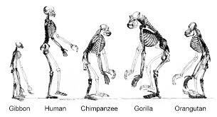
Structural Change
The structure of an organism is the result of an entire evolutionary history
There are millions of examples that results in structural changes
Example: a polar bear has thick fur to keep it warm (like most bears) but they also have thick fur on their feet to keep them warm and improves traction

Slide 43
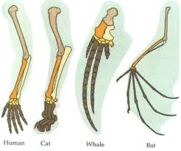
Structural Change
The limbs of animals have evolved from a similar structure.
Example: humans have a long thick bone, two thinner bones and then a hand.
Birds have a thick bone, two thinner bones, and what looks like 2 digits,
Whales and bats are all similar

Slide 44
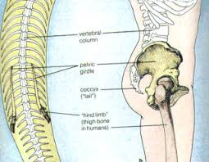
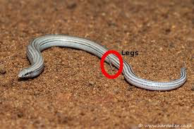
Structural Change
Some modern organism give clues to their evolution
Example: some snakes have tiny, nonfunctional leg bones
This suggests that they probably evolved from four-legged, lizard like ancestors

Slide 45
Functional Change
Molecular or biochemical changes affect how an organism works
Example: working muscles emit an electrical pulse, in some eels the pulse is amplified and can stun or kill prey
Changes in DNA
Example: a change in a uni-cellular organisms can now produce an enzyme that digests wood
Example: some snakes make venom

Slide 46
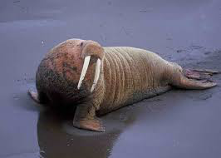
Behavioral Change
A lot of the behaviors we see today have evolved to help with reproductive success
Example: fighting between walrus’s for groups of females is evolved.
Because the winner is a stronger and healthier mate
Example: the rate of blinking allows males and females of firefly species to find each other
A different rate would isolate that individual from potential mates

Slide 47
Importance of Variation
If environmental conditions change, organisms that cannot adapt to those conditions may die
If all the organisms in a species had the same characteristics and there was an environmental change it could kill them all
If there is variation, some will survive
Once a species characteristics has died off, it will not come back
Endangered species worry scientists because their numbers are so small, they may not survive environmental change

Slide 48
Patterns of Change
Evolution seems to follows patters that appear repeatedly in the fossil record
Changes in species are related to environmental change
Species with short reproductive cycles produce many offspring and tent to evolve more quickly than species with long lifespans and few offspring
The failure to adapt to a changing environment may result in the death of the species

Slide 49
The Rate of Evolution
Most of the life on earth is believed to be the result of natural selection
The amount of change seems to be linked to time and environmental changes
The more stable the environment, the less evolution
Rapid changes in the environment leads to much change
It may take millions of years for the changes to classify it as a new species

Slide 50
The Rate of Evolution
The rate of evolutionary change may be influenced by the number of offspring produced by the species
Organisms that have few offspring, live longer so they don’t change as much
Organisms that have short lives produce more rapidly and change quickly
Example: antibiotic resistant bacteria. Those that will not be killed by antibiotics will continue to live and reproduce

Slide 51
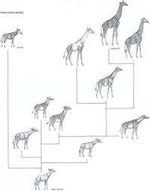
The Rate of Evolution
Example: Insects produce many offspring and have short reproductive cycles. If a pesticide is used, some may have resistance and live on after it’s use to reproduce, increasing the population of that resistant insect

Slide 52
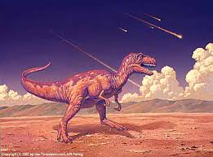
Extinction
Extinction = disappearance of an entire species
This happens when death rate is higher than birth rate
Generally happens when the environment changes
Temperature change, sea levels rise or fall, grasslands become deserts, pollution,
Variations in organisms can help the organism survive but if they cannot adapt, they may become extinct

Slide 53
Adaptive Value
Any trait that helps an organism to survive and reproduce under a given set of environmental conditions
Rabbits fur or moth color may allow them to blend in with the surroundings allowing them to escape capture from a predator
Those that do not posses these beneficial traits have a greater chance of being removed from the population changing environments are often driving force for evolutionary change

Slide 54
Patterns of Evolution
Divergent evolution – 2 related species becoming more and more dissimilar
Convergent evolution – unrelated species becoming more and more alike in appearance as they adapt to similar environments
Co-evolution – change of 2 or more species in close interaction – hummingbirds and the flowers that they pollinate

Slide 55
Evidence of Common Ancestors
Homologous structures – common anatomical structures or embryological similar structures
Bat wings, whale flippers, bird wing, human arm and hand, alligator foot
Vestigial Organs – functionless parts of organisms
Tail bone in humans, leg bone in snakes, eyes of blind fish, pelvis bones in whales
Normally thought to have a purpose in a related species but has no purpose in the current species

Slide 56
Evidence of Common Ancestors
Embryological development – embryos if different species develop almost identically
Especially true in the early stages of development
Common Proteins = common DNA
Blood proteins are shared by multiple species
Muscle proteins are also shared by more than one species
Analogous Structures – structures that are similar in function but not share physiological traits
Bird wings have bones, moth wings do not

Slide 57
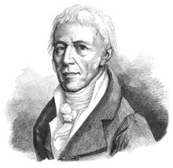
Lamarck Vs Darwin
Lamarck came before Darwin, but was missing some pieces and more importantly he was missing required evidence
Larmarck said that traits developed by living organisms were passed down to the offspring
Darwin put the pieces together and said that it was inherited traits – not acquired traits that were passed on

