Slide 1
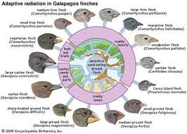
Speciation & Population Change

Slide 2
Organization of Organisms
Taxonomy – branch of science concerned with classification, especially organisms
Taxonomy of organisms

Slide 3
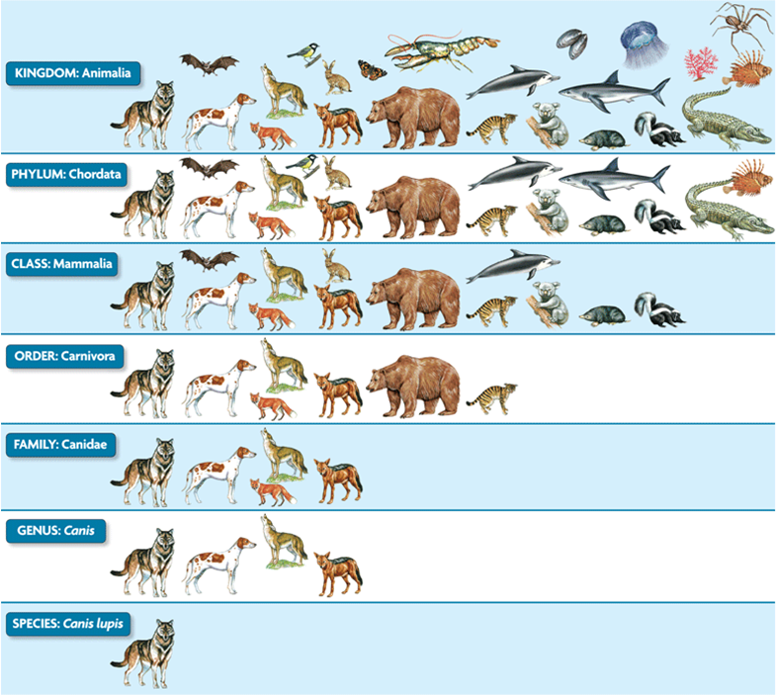

Slide 4
Species
Speciation – process that causes a new species to develop
Species – a group of individuals that look similar and are capable of producing fertile offspring

Slide 5
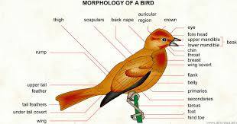
Morphology
Similarities and differences in internal and external structures
Allows scientists to communicate characteristics, behavior, and relationships of organisms

Slide 6
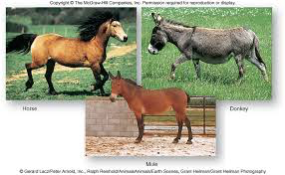
Species Concepts
Morphological species concept
Species is a classified by appearance
Biological species concept – can they breed and produce fertile offspring
Presently both are used to define species

Slide 7
Evolution of Species
How do species evolve?
Two ideas of how species get from point A to point B in terms of evolution

Slide 8
Punctuated Equilibrium
All populations of a species may exist for a long period of time and then undergo a rapid genetic change that leads to speciation
Arguments that support this include the lack of connections in the fossil records –there are fast changes with missing links that should be there if the change was gradual

Slide 9
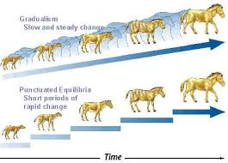
Gradualism
Population change a little bit at a time over a long period of time

Slide 10
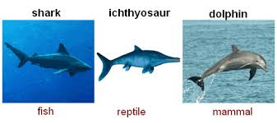
Evolution Types
Convergent Evolution – Process whereby organisms not closely related, evolve similar traits as a result of adapting to similar environments or niches
Niche – place or position in an area

Slide 11
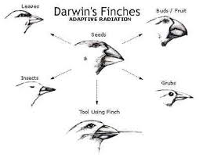
Evolution Types
Divergent Evolution – differences between groups which can lead to a new species

Slide 12
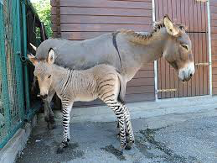
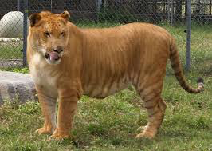
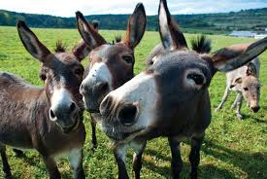
Hybrid Species
Result from the cross between two true breeding organisms that result in a new generation

Slide 13
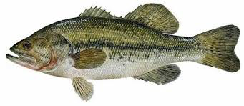
Population
All of the members of the same species that live in the same area at the same time
Example – all of the largemouth bass that live in the same area at a particular point in time
Why is it important to have boundaries and a set time when defining the population?

Slide 14
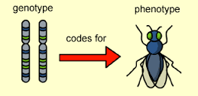
Population Variation
What gives an individual its appearance?
DNA – genes
Genotype
What is the appearance or traits resulting from the genotype called?
Phenotype
All of the genes in a population make up the gene pool
Alleles are the types of a specific gene

Slide 15
Hardy –Weinberg Principle
A population will remain at genetic equilibrium only if the following conditions are met
No mutations occur
No migration out or immigration into the population occurs
Population must be large
Individuals mate randomly
Natural selection does not occur

Slide 16
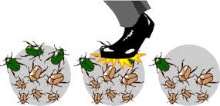
Hardy –Weinberg Principle
If these conditions are not met, evolution will occur
Genetic drift is when the allele frequencies or the trait resulting from genes shift in a population as a result of random events or chance
Deer with spots are all crushed under a mudslide

Slide 17
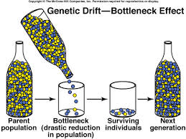
Genetic Causes of Evolution
Bottle neck effect – The population is drastically decreased
Decreases the amount of allele possibility

Slide 18
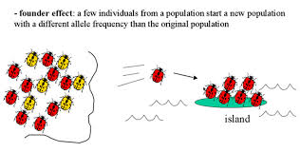
Genetic Causes of Evolution
Founders effect – Loss of genetic variation that occurs when a new population is established by a very small number of individuals from a larger population

Slide 19
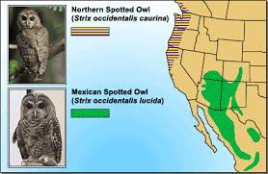
Isolated Populations
Isolated populations lead to new species
2 types of isolation
Geographical and reproductive
Geographical occurs when there is a physical barrier separating populations
River, mountain range

Slide 20
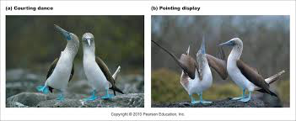
Isolated Populations
Behavioral Isolation – two species that do not mate due to differences in courtship rituals

Slide 21
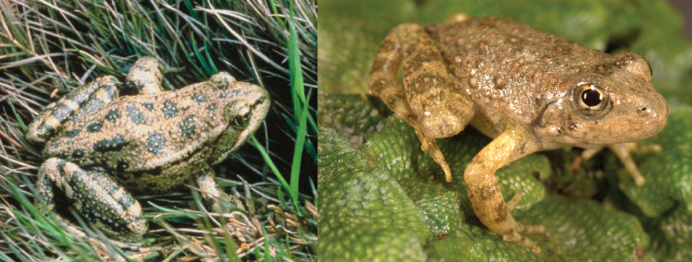
Isolated Populations
Reproductive isolation occurs when members of the same species cease to reproduce together
Wood frog and leopard frog are capable of producing fertile offspring, but breed at different times that do not overlap

