Slide 1
Movement Through Membranes
And Biochemistry Review

Slide 2
How do molecules move through space?
Gradient is a slope
Shows the difference in concentration across a membrane or space
Can also show the difference of pressure, temperature, and electrochemical properties
Concentration
Amount of solute (_________________________) in a given amount of solvent (________________)
5 g of salt in 100 ml of water = 5 % concentration

Slide 3
Diffusion
Movement of molecules from an area of greater concentration to an area of lesser concentration
Continues until the molecules are evenly distributed
Reach _______________
The molecules are still moving but at about equal rates from one side or area to another so that no measureable difference can be observed.

Slide 4
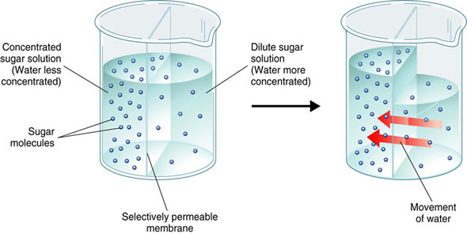
Osmosis
https://www.youtube.com/watch?v=SrON0nEEWmo
Movement of water into or out of a cell
Water will move to an area of lower concentration
No energy is required – the water just flows

Slide 5
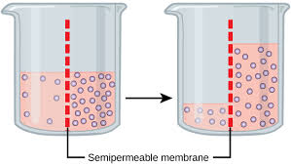
Why things move?
Concentration
How much of something is in a given area

Slide 6
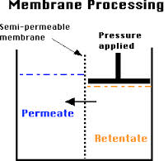
Why things move?
Pressure
How much force is being distributed over an area

Slide 7
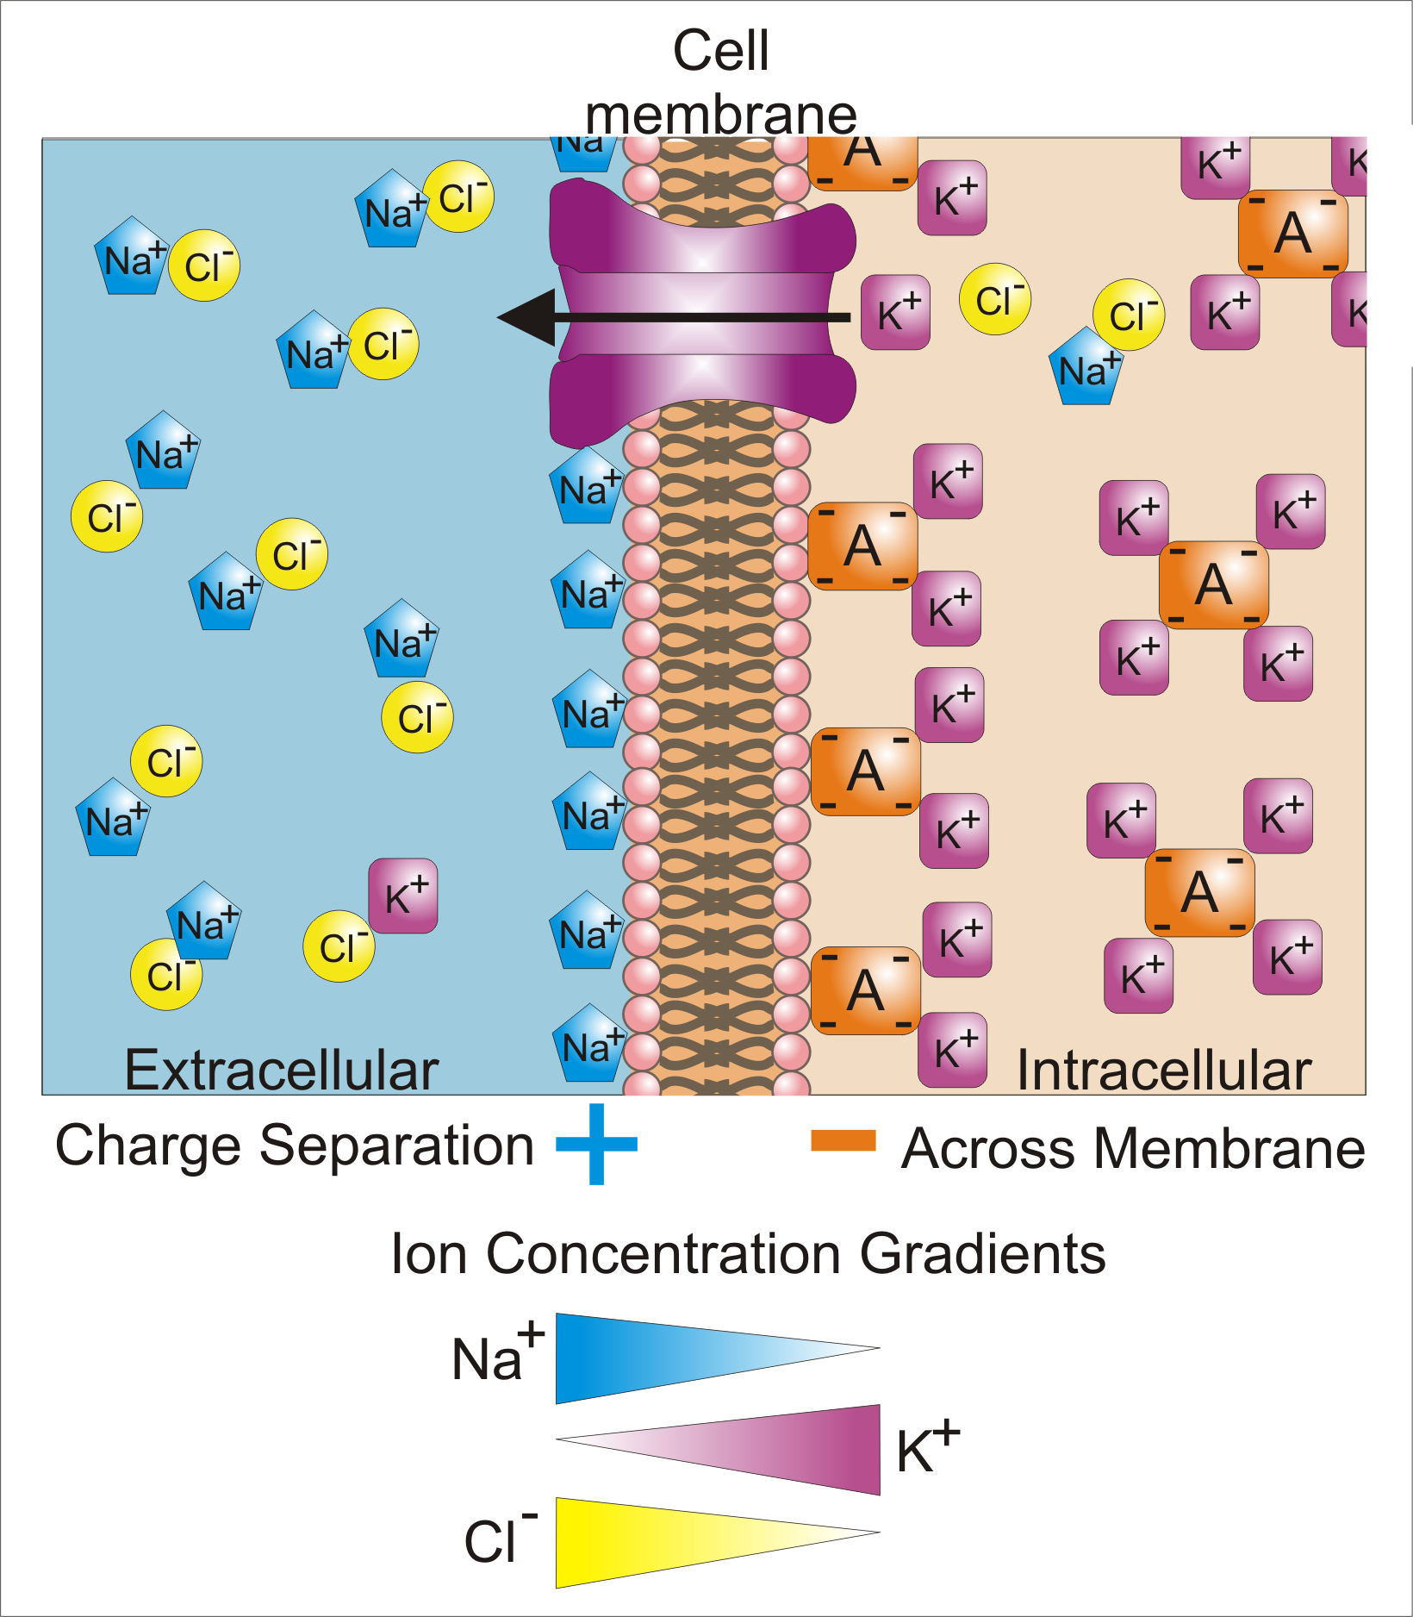
Why things move?
Voltage
Difference in electrical charge over a membrane

Slide 8
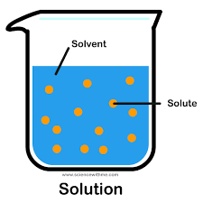
Solutions
Solution= A substance that is dissolved within another
Solute= ________________________
Solvent= ________________________

Slide 9
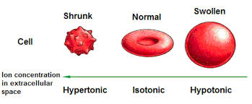
Solutions and Membranes
Hypertonic
Hyper = ___________
Describes a solution that has a higher concentration of solute than that on the other side of the membrane

Slide 10
Solutions and Membranes
Hypotonic
Hypo = ______________________
Describes a solution that has a lower concentration of solute that that on the other side of the membrane

Slide 11
Solutions and Membranes
Isotonic
Iso = _____________________________
Describes a solution that is equal to a solution on the other side of a membrane

Slide 12
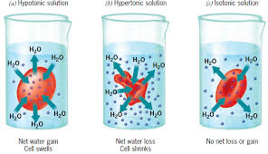
Solutions in Cells

Slide 13
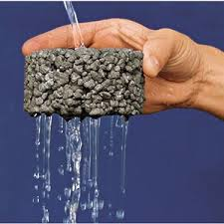
Solutions and Membranes
Permeable
Describes a membrane (or other barrier) that allows substances to pass through it
Molecule size and the steepness of the concentration gradient determine how readily molecules will permeate (diffuse into or out of) through a cell membrane

Slide 14
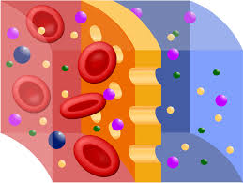
Solutions and Membranes
Semi-Permeable
Describes a membrane that will allow only certain substance to pass through based upon the size of the molecules

Slide 15
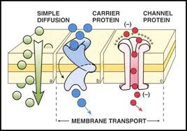
Solutions and Membranes
Selectively permeable
Describes a membrane of many living cells that only allow certain substance to enter or leave the cell base don the size, shape, chemical or charge of the molecule
The proteins of the cell membrane can regulate the passage of the molecules into and out of the cell
Cells can also force the diffusion of molecules against the concentration gradient through active transport – but this requires the use of energy

Slide 16
Pressure
What happens what water pressure builds?
In cells:
What happens what water pressure falls?
In cells:

Slide 17
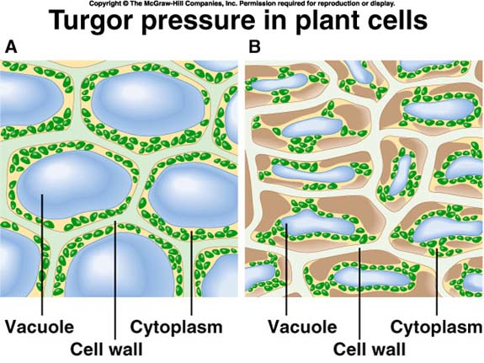
Turgor Pressure
Turgor pressure refers to the amount of water pressure in a cell
High turgor pressure = lots of water = lots of water pressure
Lower turgor pressure = little water = little water pressure

Slide 18
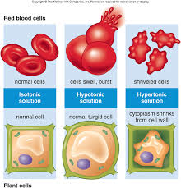
Pressure in cells
Plasmolysis
When the cell shrivels or wilts because there is very little water pressure
Cytolysis
When the cell burst because the water pressure is too much for the membrane to handle

Slide 19
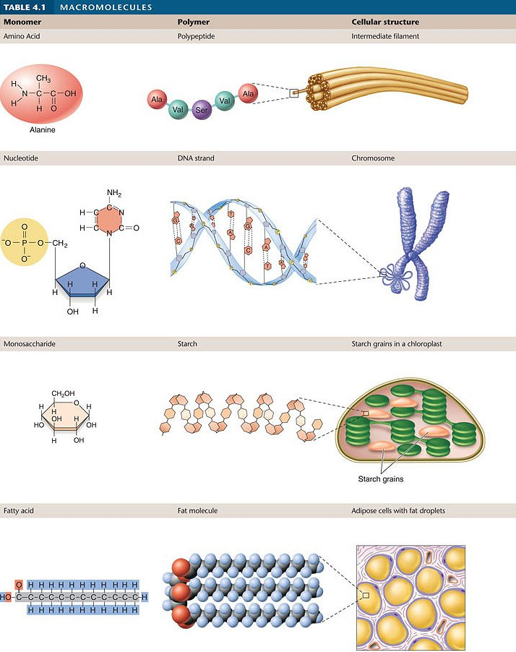
4 Organic Macromolecules

Slide 20
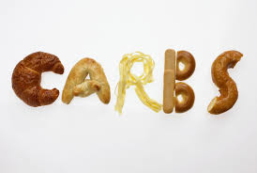
Carbohydrates
Provides use with a source of energy
Sugars
Starches
Acts as building blocks in plants
Found in grains, potatoes, fruits, many processed food and drinks
Test for sugar using Benedicts solution
Test for starch using iodine
Elements that make up carbohydrates are C, H, and O
These usually occur in a 1:2:1 ratio

Slide 21
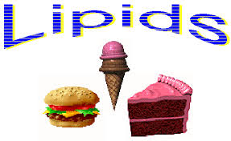
Lipids
Includes fats and oils
Act as insulation, a source of energy, and are a major part of the plasma membrane of cells
Found in nuts, animal, dairy, and some plant food sources and many processed foods
Can test for fat and oil using the paper bag test
Can test for fats oils using an organic solvent
Elements that make up fats are C, H, and O
Two types of fats
Saturated and Unsaturated

Slide 22
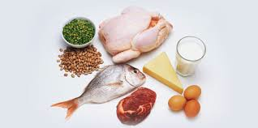
Proteins
Act as a source of energy, the building blocks of all animals and enzymes
Found in meats, some vegetables, nuts, dairy, and certain processed foods
Test for proteins using nitric acid which turns yellow in the presence of proteins
Elements that make up proteins include C, H, O, and N

Slide 23
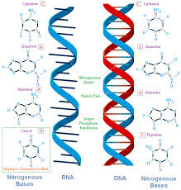
Nucleic Acids
Contain genetic information specific to the organism which it is from
Found in all living things
Elements that make up nucleic acids are C, H, O, N, and P

Slide 24
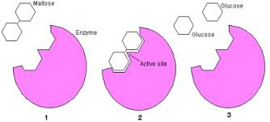
Extras
‘ase – some type of enzyme
Amylase
Protease
Lipase
Amino acids are the building blocks of proteins
Proteins are made in the ribosomes
Therefore they also build enzymes

Slide 25
Extras
Starch is a carbohydrate that is made from many sugars bonded together
Cellulose = a polysaccharide = a carbohydrate found in plants
Nucleotides = repeating units that make DNA and RNA

Slide 26
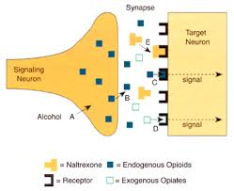
Extras
Receptor molecules can be for chemical or voltage “signals”
Receptor molecules are made to either receive specific molecular structures or a certain charge that then cause them to cause the cell to respond either by performing an action or by expressing a gene
Examples is adrenaline and the response once adrenaline is released
Examples is insulin and the response on blood sugar levels when it is released

