Slide 1
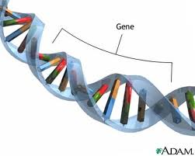
Genetic Continuity
Replication, Transcription, Translation & Genetics

Slide 2
Overview
When two organisms reproduce, their offspring get their genetic instructions from their parents genes.
The genes determine which traits (characteristics) each offspring will have.
All organisms pass their traits on in this manner
Because of this, many offspring resemble their parents

Slide 3
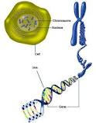
Heredity and Genes
Heredity = passing of genetic information from generation to the next through reproduction
DNA is organized in the form of genes in the chromosomes of each cell
Recall that chromosomes, found in the nuclei, contain DNA molecules

Slide 4
Heredity and Genes
Human cells have thousands of genes in the nucleus
Each gene has a separate piece of coded information
A single gene pair can influence more than one trait however
Some traits are easy to see
Hair color, leaf shape, flower scent, wing structure
The overall body shape is also an inherited trait
Long slender toes or long ear lobes
Some traits are not as easily visible
Defective heart, single kidney, hormonal imbalance, diabetes,

Slide 5
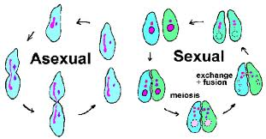
Methods of Reproduction
Two common methods of reproduction
Asexual = Just one parent (single-celled organisms)
Sexual = two parents

Slide 6
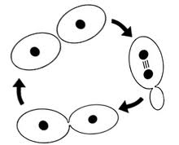
Asexual Reproduction
All the genetic information come from one individual
This means that the offspring are normally identical to that parent
The genes are the same as those in the parent
Identical genetic copies are known as clones
Bacteria for example thousands and thousands of cells can be clones

Slide 7
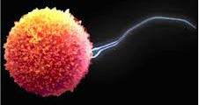
Sexual Reproduction
Two parents are required to produce offspring
Each parent produces a sex cell
Eggs = Female
Sperm = Male
All body cells have a pair of chromosomes
Sex cells only have a single chromosome of each type
This is so when the cells combine, they have a pair

Slide 8
Genetic Recombination
When the sperm and egg combine, a unique new cell is created
This process is known as genetic recombination
The offspring may resemble either or both parents but the offspring may not be identical to either
Can inherit different genes and alleles from each parent
Gene =
Allele=

Slide 9
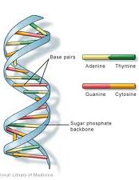
Genetic Code
The genes that are passed from parent to offspring exist in the form of a chemical code
It’s called the genetic code
DNA resembles a flexible, twisted ladder formed from many smaller repeating units
Found in Nucleus of eukaryotes
Tightly coiled
Found in ring called a plasmid in prokaryotes

Slide 10
DNA Structure
DNA is made of thousands of small sections called subunits
Each subunit has 3 smaller parts
A sugar (Deoxyribose = 5-Carbon Sugar) , a phosphate group, and a nitrogen base
This is known as a nucleotide
The subunits vary from one another according to the kind of base they have
The bases are represented by letters
A, G, C, T

Slide 11
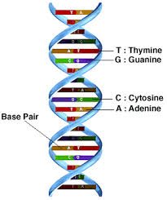
DNA Structure
The four subunits are arranged in pairs
The two sides come together to form a rung on the “twisted” ladder
Called a Double Helix
The nitrogen bases pair up…
A with T
G with C

Slide 12
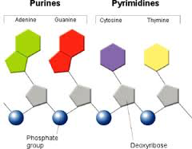
Nitrogen Bases
A = Adenine
T = Thymine
C = Cytosine
G = Guanine
A and G are purines – they have double ring of carbon and nitrogen atoms
T and C are pyrimidines – they have a single ring of carbon and nitrogen atoms
A double ring is compatible with a single ring so they pair up – form a chemical bond

Slide 13
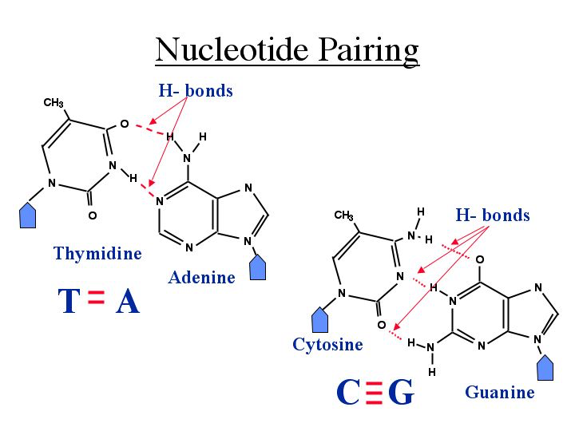
Bonds
Hydrogen bonds hold the nitrogen bases together
They share a proton
A + T = 2 Hydrogen Bonds
C + G = 3 Hydrogen Bonds

Slide 14
Genetic Code
Once the chemical and structural properties of DNA were discovered, it was obvious that it could contain a code
There are countless combinations of codes in countless orders that could give meanings
Example: ACAG, AACG, GACA could all have different meanings even though there are composted of the same bases
The genetic code for an entire human is established by around 3 billion base pairs

Slide 15
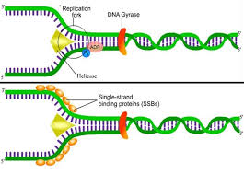
DNA Replication
The ability to copy the codes in DNA is critical for its function
The bases use weak bonds between the pairs to hold the sides of the ladder together.
The bases can pull apart at the weak bond to form two separate strands.
Each strand then becomes a template (pattern) for a new molecule
https://www.youtube.com/watch?v=8kK2zwjRV0M

Slide 16
DNA Replication
1. DNA helicase (an enzyme) attaches to a DNA molecule
2. DNA helicase moves along the molecule, unzipping the 2 strands of DNA
It breaks the H bonds between the nitrogen bases
3. unpaired bases react with complimentary bases of nucleotides
4. New H bonds are formed
DNA polymerase (an enzyme) catalyzes the process
5. Two identical molecules are formed
Each contains one old and one new strand

Slide 17
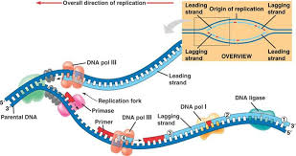
DNA Replication
Multiple sites are used to replicate the cell faster
Example – 1 DNA molecule from a fruit fly takes 16 days to be replicated with only 1 enzyme
The same DNA molecule under normal circumstances with around 6,000 sites take ~ 3 minutes

Slide 18
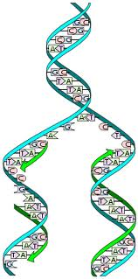
DNA Replication

Slide 19
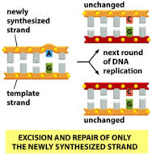
Errors
Errors are rare, but they do happen
Proofreading enzymes go through the DNA molecule and repair errors made during replication
In the end, errors occur at the rate of around 1 error/ billion nucleotides

Slide 20
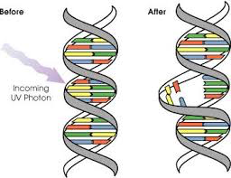
DNA Damage and Repair
Damage to DNA is caused by heat, radiation (sun), and chemicals (cigarettes)
What does this have to do with cancer?
Body heat itself is able to break the bonds between Deoxyribose (sugar) and purines (adenine and guanine)

Slide 21
DNA Damage and Repair
Repair enzymes replace the damaged nucleotides with undamaged ones – errors rarely go unnoticed
Carcinogens can elevate the chances of damage to occur and increase the chance that a damaged strand can go without being repaired

Slide 22
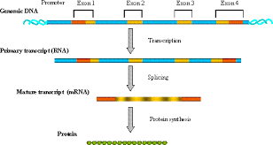
DNA Expression
DNA is the blueprint for the body
There is some extra information that is not used
This extra is like a buffer
Useable DNA is information that can be expressed in the form of genes
Expressed genes make proteins

Slide 23
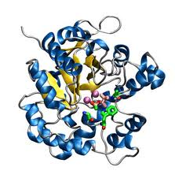
Proteins and Cell Functioning
The work of the cell is carried out by the many molecules the cell makes (synthesizes)
Many are proteins
Proteins are long chains
Proteins are formed from various combinations of 20 kinds of amino acids arranged in sequences

Slide 24
Proteins and Cell Functioning
The sequence of amino acids creates the shape of the molecule
Some of the amino acids are attracted to other amino acids, they bond
These bonds form folds and bends.
The shape of the protein allows it to carry out its function in the cell
Enzymes are proteins that need a specific shape to function

Slide 25
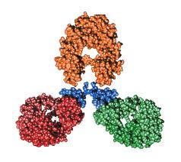
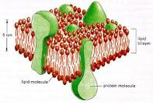
Proteins and Cell Functioning
Some proteins in the cell work within organelles
Some are imbedded in the cell membrane
Some are hormones, antibodies…
Proteins give your eyes and skin their color

Slide 26
The DNA-Protein Connection
Cells store large amounts of coded information in the genes
A lot of the genes are used to make proteins
Proteins are made at the ribosomes based on the DNA codes
Because offspring get their genes from their parents, the proteins produced are very similar
This is what causes the resemblance between the offspring and their parent(s)
The same types of proteins, with similar shapes give a resemblance
Hair texture (curly, straight) is determined by a protein

Slide 27
The DNA-Protein Connection
If a parents DNA is coded so that a protein does not function properly, the child may get the defective code and therefore defective protein production
Example: An albino does not produce the usual amount of eye, hair, or skin color pigment.
The condition arises from a defective gene passed onto the child from a parent

Slide 28
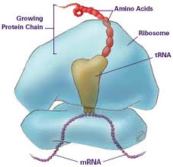
Protein Synthesis
The process of synthesizing protein from DNA begins in the nucleus.
The DNA code is read by a special enzyme and then used to produce a “messenger” molecule
The messenger travels to a ribosome
Transfer molecules bring amino acids to the ribosome to be connected to make the protein
The overall structure of the protein is determined by the gene’s DNA sequence in the nucleus

Slide 29
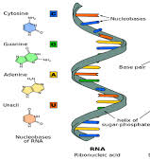
RNA
RNA is a single strand
Sugar molecule = ribose
Base uracil takes the place of the thymine
There are three different types of RNA
Messenger RNA (mRNA)
Transfer RNA (tRNA)
Ribosomal RNA (rRNA)

Slide 30
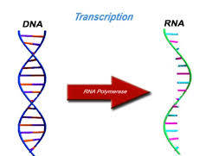
Transcription
Transcription occurs when the cell is between divisions and the DNA is stretched out as individual strands
RNA nucleotides attach themselves and form a RNA chain
Each gene produces a mRNA molecule
The sequence of bases can create a messenger RNA which can code for the sequence of amino acids that will make a specific protein chain
Other regions produce transfer RNA
Carry amino acids to the code to build the protein

Slide 31
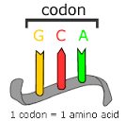
Codon
Codon is a specific group of 3 sequential bases of mRNA
Each codon codes for a specific amino acid which is identified by the tRNA
64 possible codons
There are 20 amino acids – several codons can identify an amino acid
The universal start sequence is AUG
The universal stop sequence is UGA
Anticodon is a sequence of tRNA that is complimentary to mRNA
Helps to determine the order of amino acids
Information from several genes may be used to form one protein

Slide 32
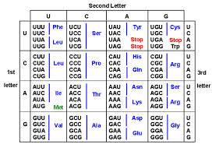
Codon Chart

Slide 33
Protein Synthesis
mRNA moves from the nucleus to the ribosome
Coded message of the mRNA is “read” at the ribosome and is converted into a chain of amino acids
Each molecule of tRNA has a segment that becomes attached to a particular amino acid in the cytoplasm
The other end of the tRNA has an anticodon of 3 bases that matches a codon on mRNA for that particular amino acid

Slide 34
Protein Synthesis
At the ribosome
tRNA molecule with its amino acid temporarily bonds to its complimentary codon on the mRNA molecule
mRNA molecule then moves past the ribosome to the next codon and another tRNA molecule bonds to it
An enzyme then joins the amino acids, forming the protein chain
Each tRNA molecule is released to repeat the task as the mRNA molecule moves

Slide 35
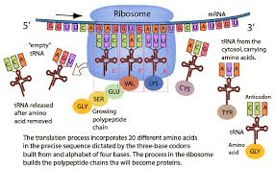
Translation

Slide 36
Mutations
Genes are segments of DNA
Mutation = changes the normal message carried by the gene
Even a small change in the DNA can lead to a big alteration in the expression of a gene
Many mutations involve a substitution of one base for another
This will cause a different amino acid to be placed in a protein
Some mutations involve an insertion of an additional base into the sequence
Like skipping a question on an answer sheet it effects everything after it, making most of them wrong

Slide 37
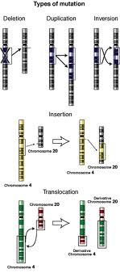
Mutations
Some mutations involve the deletion of a base form the code
This also alters everything after it
Some mutations involve a rearranging of some bases
This causes amino acids to alter locations

Slide 38
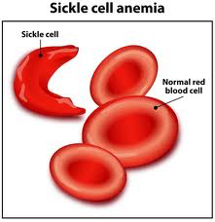
Mutations
These mutations are random and can be anywhere in the molecule
This makes it really hard to predict how it can effect a protein
When the DNA is altered it is very possible that the protein will be assembled incorrectly
This will effect the folding of the protein
This may result in the inability of the protein to function
Example: Sickle Cell Disease
The shape of the red blood cell is altered, it cannot hold oxygen well

Slide 39
Mutations
Mutations can be so serious that the cell may die
If a mutated cell passes along its DNA, ever cell in the body can have that defective code
In reproduction, only mutations in sex cells can be passed along to the offspring

Slide 40
DNA and Individuality
The body is made up of many cells even though all the cells come from a single cell
Every cell’s nucleus contains the same exact genetic information
How can cells have all the same information but be so different?
Each cell only uses some of the genetic information
It only uses the information it needs to run that particular type of cell

Slide 41
DNA and Individuality
The internal and external environment of a cell can influence the genes that are activated and expressed
This may help to influence the differentiation of cells during development
Selective activation of genes can continue as conditions change throughout life
Hormones can activate a particular gene, producing a specific protein

Slide 42
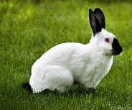
DNA and Individuality
Even though genes are inherited, the environment can still affect the way some of the genes are expressed
Example: Himalayan rabbit:
As the outside temperature changes it can activate or inactivate genes for fur color
When the rabbit is cold, black fur grows
When the rabbit is warm, white fur grows
Example: Identical Twins in different environments
Different genes are expressed as a result of the environment

Slide 43
Genetic Engineering
Genetic Engineering = new technology that humans use to alter genetic information in organisms
The organism may be altered for more desirable traits
This isn’t all that new
Biotechnology has been used to produce useful products for thousands of years
Biotechnology = applying technology to biological science

Slide 44
Genetic Engineering
Selective breeding = a process that produces domestic animals and new varieties of plants with traits that are favorable
Many meats come from animals that have been breed to contain less fat
Many fruits and vegetables we eat have been bred to be larger, sweeter, hardier, or juicier
To do this a cross is made between to favorable organisms
Farms may cross a bean plant with lots of pods with a plant that resists fungus growth; the offspring may have both features

Slide 45
Gene Manipulation
Plants and animals have been genetically engineered by manipulating their DNA
The manipulations result in new characteristics and new varieties of organisms
This allows us to make new beneficial organisms
Example: Plants that resist chemicals but kill bugs that feed on the plants
Example: Bacteria that clean up oil spills
Example: Bacteria that produce human growth hormone

Slide 46
Gene Manipulation
The method of altering genes in organisms uses special enzymes
The enzymes cut DNA segments so they can be “spliced” (moved and attached) to the DNA of a new organism
Once the gene has been spliced into the DNA, that organism will produce that protein
Example: human gene for insulin can be spliced out and placed into a bacteria cell. The bacteria cell will then produce insulin
The insulin can then be used in diabetics to control blood sugar

Slide 47
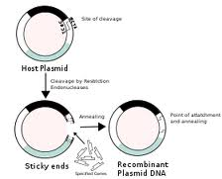
DNA Recombination

Slide 48
Gene Manipulation
Other enzymes have been found that can be used to make lots of segments of DNA
These can be used to make lots of copies of a DNA segment which we only have a small amount of.
This can be done with DNA found at a crime scene
The DNA sample can be amplified (multiplied) many times so that the DNA can be compared to suspects DNA.

Slide 49
Applications of Biotechnology
Healthcare can benefit from genetic manipulations
Locate and decode genes that cause diseases
We could then develop ways to treat the disease
We may be able to alter the DNA in affected cells to cure a person
People with genetic disease are sometimes unable to produce certain hormones, enzymes or other chemicals
At one point in time we used the same chemical from animals but it was expensive and had side effects. Now we can use genetically modified organisms to produce the same human hormones for us

Slide 50
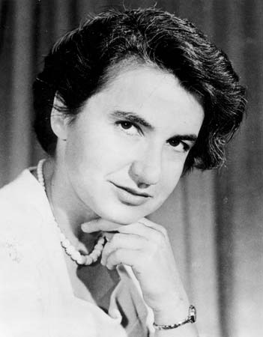
Human Genome Project
Set out to map the human genome.
They wanted to identify what all the pieces of DNA code became as proteins and what they effected in the body
Completed in April 2003
Started due to great discoveries by Watson, Crick and Franklin.

