Slide 1
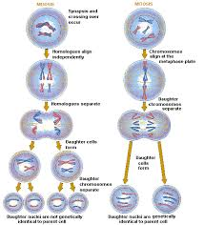
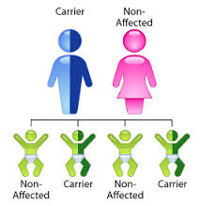
Reproduction and Inheritance

Slide 2
Overview
Species = group of closely related organisms that share certain characteristics and can produce new individuals through reproduction
For any species to survive, they must reproduce
All individuals will die but their species will live on through reproduction
Offspring begins a period of development that ends in adulthood
Once an individual reaches adulthood, it is usually able to reproduce and continue the species

Slide 3
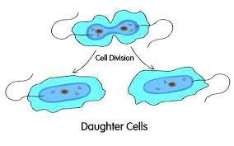
Types of Reproduction
There are two methods of reproduction:
Asexual
Sexual
Asexual reproduction involves just one parent
Results in one or more offspring that are genetically identical to the parent

Slide 4
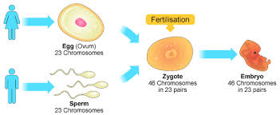
Types of Reproduction
Sexual reproduction involves two parents
Some genetic material (DNA) comes from each parent
The result is an organism that may be similar to one or both parents but is not identical to either

Slide 5
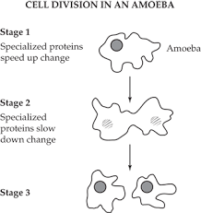
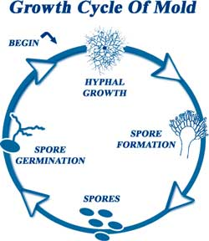
Asexual Reproduction
Organisms that reproduce asexually produce offspring in a variety of ways.
Some just divide in two: produces two new individuals
The parent becomes an offspring
Eg: Ameba divides into two ameba
Some organisms produce special cells that have a complete set of genetic information
These parts develop into new cells
Eg: Mold spores reproduce mold

Slide 6
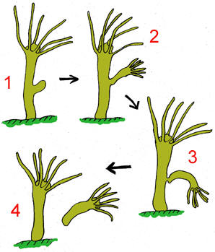
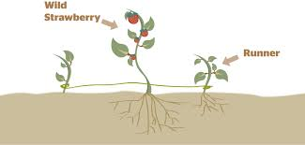
Asexual Reproduction
Others produce an outgrowth of the body that detaches to become a separate individual
Some plants can regrow from broken pieces of the larger plant
Eg: Hydra bud off a smaller version of itself
Eg: Strawberry plants can have runners that produce another strawberry plant
In all cases the DNA is exactly the same in both

Slide 7
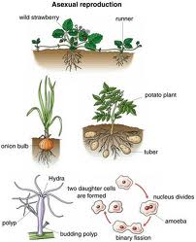
Examples of Asexual Reproduction

Slide 8
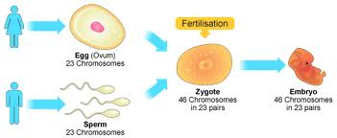
Sexual Reproduction
Offspring get half of their genes from one parent and the other half from another
The genes are carried on chromosomes in sex cells
Sex cells = gametes (egg or sperm cells) = haploid cells
Haploid = ½ of the number of chromosomes

Slide 9
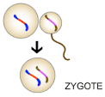
Sexual Reproduction
Two gametes join in fertilization
Each parent supplies one of the gametes with half of their genetic information
Sperm from father = formed through spermatogenesis
Egg from mother = formed through oogenesis

Slide 10
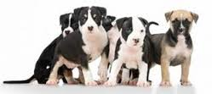
Sexual Reproduction
Offspring combine genes inherited from each gamete
An offspring gets only half of its DNA from each parent so it will not be identical to either
Each offspring gets a unique combination of genes from the parents, each offspring is different from its siblings (brother or sisters)

Slide 11
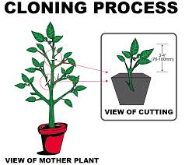
Cloning
Cloning = technique that accomplishes the same end result as asexual reproduction
Way of making identical genetic copies
Example: if you cut a piece of stem from a plant and it grows roots and develops into a new plant, it would be genetically identical = clone

Slide 12
Cloning
It has recently been possible to clone animals that normally reproduce by sexual reproduction
The nucleus of an egg is removed and replaced with a nucleus that contains 100% of the genes from a single parent.
The egg is allowed to develop normally
The new organism that results is a clone of the parent cell
In mammals, the egg would be implanted into the body of a female to develop
Cloning has been possible with complex organisms like sheep or pigs

Slide 13
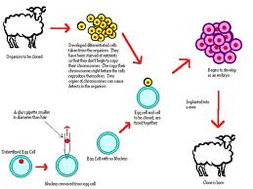
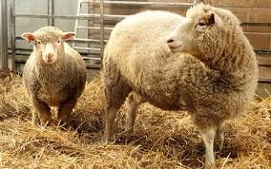
Cloning

Slide 14
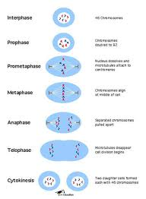
Cell Division
Cell division = orderly separation of one cell into two
Before the cell can divide the DNA is duplicated (copied)
The process that produces two complete sets of the DNA = mitosis
Mitosis produces 2 cells that have a full set of identical genes and chromosomes
Unless a mutation occurs

Slide 15
Cell Division
Due to mitosis, each new cell has all the information it needs to function properly
One-celled organisms make use of mitosis for asexual reproduction
Multi-cellular organisms mainly use mitosis for growth and for cell replacement and repair

Slide 16
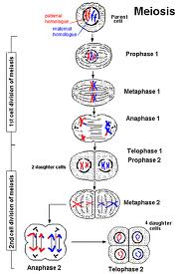
Cell Division
There is another type of division, meiosis
Meiosis = process that divides the genetic material in a way that results in the production of the sex cells required by organisms that reproduce sexually
Each sex cell has half the genetic information, this is done through meiosis

Slide 17
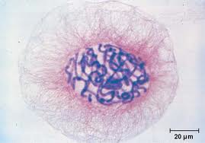
Mitotic Division/Mitosis
During mitotic cell division (mitosis), the double stranded chromosomes that are visible during mitosis split into two identical single strands and move to opposite ends of the cell

Slide 18
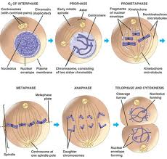
Mitotic Division/Mitosis
The process is done when the cytoplasm divides
Results in two small but genetically identical cells

Slide 19
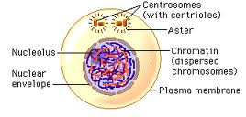
Interphase
Interphase is a period of growth and genetic replication

Slide 20
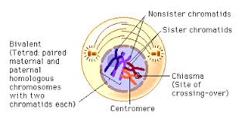
Prophase
Prophase is a stage where two centrioles form and move toward poles
The nucleus disappears
Chromatin coils into chromosomes

Slide 21
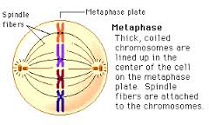
Metaphase
In metaphase, chromosomes line up at the equator

Slide 22
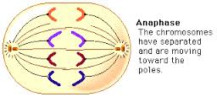
Anaphase
Anaphase – fibers pull the chromatids toward the centrioles at the poles
Chromosomes are pulled into chromatids

Slide 23
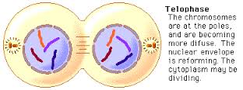
Telophase
During Telophase, Chromatids are at the opposite poles
Chromatids unwind into chromatin
A threadlike structure of DNA

Slide 24
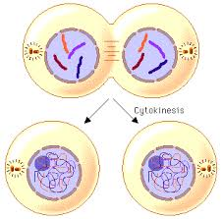
Cytokinesis
During cytokinesis, the two cells split apart into 2 daughter cells

Slide 25
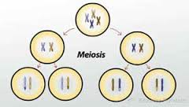
Meiotic Division/Meiosis
Gametes (sperm + eggs) formed during meiotic division have only half of the parents genetic material
Only one chromosome of each parents pair is present in the cell (rather than both chromosomes)
A cell needs two sets to function
When the sperm and egg combine during fertilization, the chromosomes pair up and all the needed genetic information is present

Slide 26
Meiotic Division/Meiosis
Meiotic division starts with a body cell with full number of chromosomes
Depending on the species the organisms contains one or more pairs of chromosomes to determine traits
The process occurs in two phases.
It ends with 4 cells that contain ½ of the genetic material found in normal body cells.
This type of cell division can lead to sexual reproduction.

Slide 27
Meiotic Division/Meiosis
During the first phase of meiosis, the double stranded chromosomes line up in pairs in the center of the cell
Then are separated moving to opposite ends of the cell
The cell then physically divides into two cells
The second phase of meiosis involves the division of each of the new cells

Slide 28
Meiotic Division/Meiosis
In each of the cells
The chromosomes line up single file in the center
Each chromosome still has two strands
The strands are separated and move to opposite ends of the cell
The cells then split into two
Now there are 4 cells, each has half a set of chromosomes
Only one of the original pair in each cell
Can be called either sperm or egg, haploid, gametes, or sex cells

Slide 29
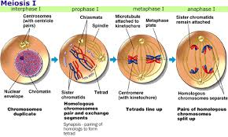
Phase 1
Interphase – Growth and genetic replication
Prophase I – each chromosome duplicates and remains closely associated
Called sister chromatids
Metaphase I – homologous chromosomes align at the equator
Crossing over can occur at this stage
Anaphase I – homologous pairs separate with the sister chromatids remaining together
Telophase I – two daughter cells are formed with one chromosome from the homologous pair

Slide 30
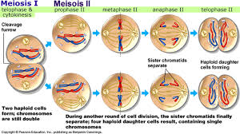
Phase 2 – gamete formation
Prophase II – DNA has not replicated – no interphase
Metaphase II – chromosomes align at the equator
Anaphase II – centromeres divide and sister chromatids migrate separately to each pole
Telophase II – cell division is complete
4 haploid daughter cells are formed

Slide 31
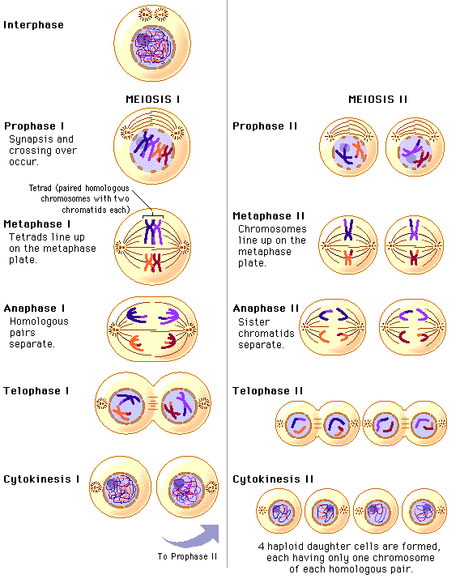

Slide 32
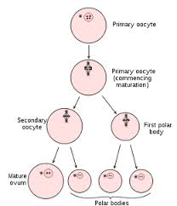
Meiotic Division/Meiosis
Meiosis and mitosis have very different end results
Mitosis = 2 exactly similar cells
Meiosis = 4 cells with half the number of chromosomes
Meiosis in males and females is exactly the same
Except for the division of cytoplasm
Males have four functional sperm
An egg divides unequally
There is one large cell that becomes the egg and three smaller nonfunctional cells

Slide 33
Meiosis as a Source of Variation
Meiosis provides a source of variation because it allows ½ of the genetic material to come from each parent
Meiosis is responsible for most of the genetic variation among sex cells in an individual
Two members of each chromosome carry different ways of expressing traits
When random sex cells pair up it can lead to many possible combinations in traits

Slide 34
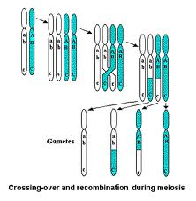
Meiosis as a Source of Variation
Variation can also occur by exchange of parts of chromosomes
Chromosomes pair up and parts of the chromosome switch
It is called crossing over
After the chromosomes split apart each chromosome is now even more unique

Slide 35
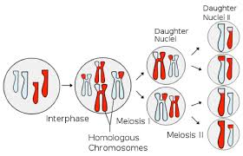
Meiosis as a Source of Variation
In all, no two sex cells are the same.
Each cell is unique

Slide 36
Summary of Mitotic and Meiotic Cell Division
Points of Comparison | Mitotic Division | Meiotic Division
Number of cell divisions | One | Two
Exchange of genetic material between chromosomes | No | Yes
Number of functioning cells produced from original | Two | Four sperm (in males) or one egg (in females)
Genetic makeup of final cells produced | Same as original | Highly variable gametes produced, each containing half of the genetic information of the original
Function of cells produced in multicellular organisms | Growth or replacement of body cells Or Asexual Reproduction | Combine to form the zygote for reproduction

Slide 37
Genetic Disorder Paper
This is a research paper
Your job is to explain your chosen genetic disorder in detail. Someone reading your paper could walk away and teach someone else about this disorder.
Introduction
½ to 1 page - Brief/General overview of the disorder
Body of the paper
3-4 pages cite research and ideas (name, year)
½ to 1 page conclusion – summarize your greatest argument
Literature Cited
Name, title, year, journal, pages
Web – name, title, website, year
AT LEAST 5 different sources – Creditable sources!
Wikipedia is not a creditable source
Size 12 font, arial, 1” margins, Double spaced
Due date:______________

Slide 38
Inheritance
Inheritance = act of genetic transmission of traits from parents to offspring
During meiosis sex cells are created.
These cells have a haploid number of chromosomes
There also may be crossing over or mutations to add to the variation in inheritance
It is also random which egg and sperm will combine to form the zygote (cell resulting from fertilization)

Slide 39
Inheritance in Plants
Plants – 2 types of pollination
Cross-pollination is the fertilization of the egg from one plant by the sperm of another plant
Animals and wind aid in this process.
Self-pollination is the fertilization of an egg by the sperm of the same plant.
May be from the same flower or another flower on the same plant

Slide 40
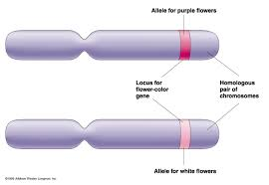
Inheritance
Gene = a segment of DNA (on a chromosome) that contains the code for a specific trait
Allele = one of two or more alternative forms of a gene that are found at the same place on the chromosome

Slide 41
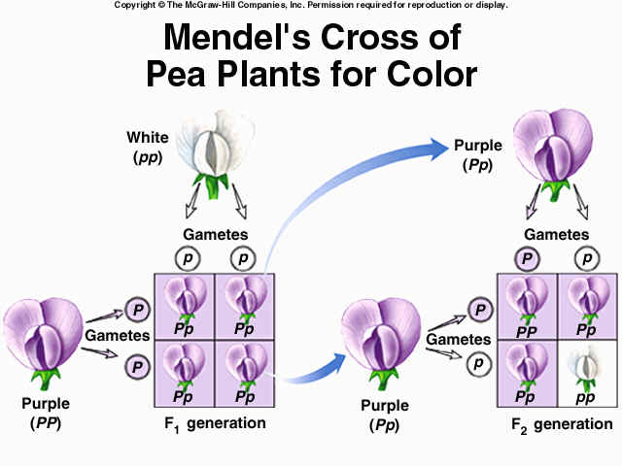
Inheritance
The dominant allele will always show itself as a physical, behavioral, or functional trait
The recessive allele will only show itself in the absence of a dominant allele

Slide 42
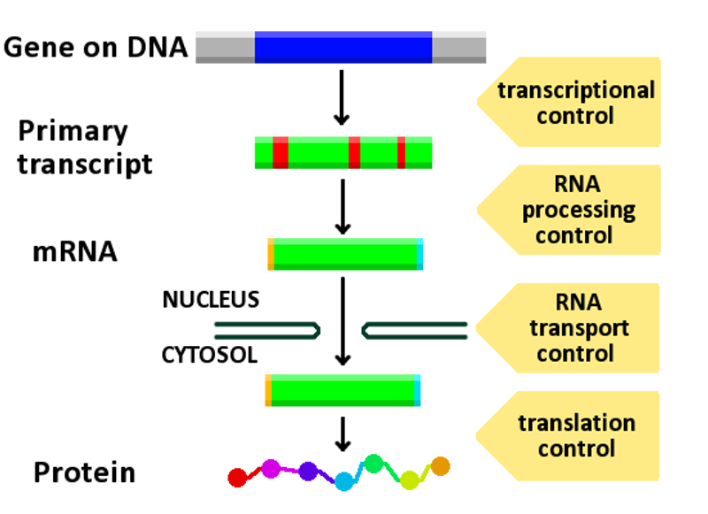
Gene Expression
A gene is expressed when the gene produces a protein
Sometimes a gene will not function the same when under different environmental conditions
Plant being white in the absence of sunlight
Sunlight is needed to stimulate the gene responsible for producing chlorophyll

Slide 43
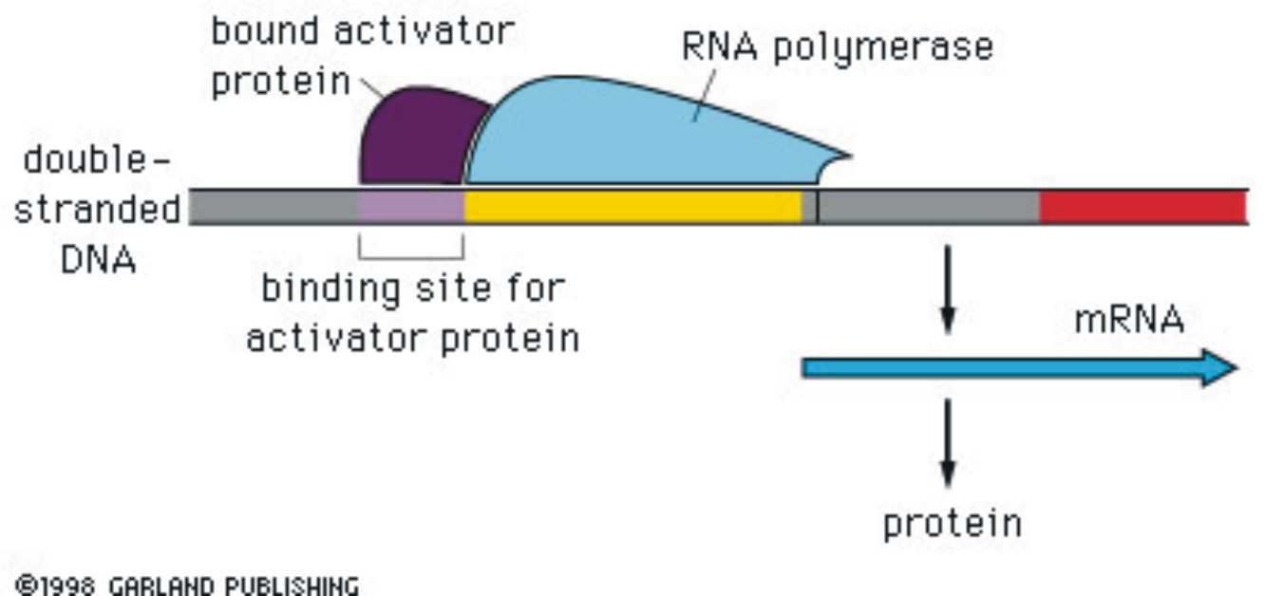
Gene Expression
Gene expression is the result of activated genes
You would be a real mess if every gene was expressed in every cell

Slide 44
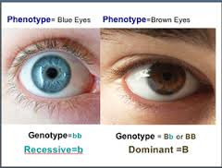
Gene Expression
Genotype – the pair of alleles
Phenotype – the physical, behavioral, or functional trait that results from the genotype

Slide 45
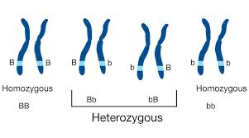
Gene Expression
Homozygous
Recessive – 2 like alleles that are recessive in nature
Dominant – 2 like alleles that are dominant in nature
Heterozygous – one dominant and one recessive allele

Slide 46
Punnett Square
Punnett squares are used to simulate a cross between parental characteristic and predict the probability of the traits being passed onto the offspring

Slide 47
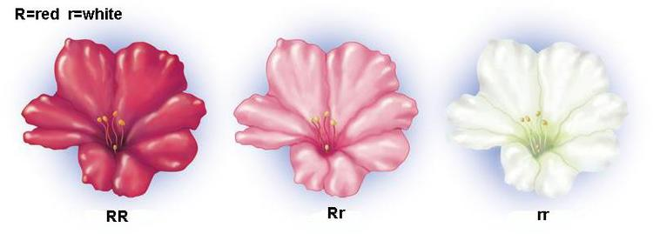
Shared Gene Expression
Shared dominance is when both alleles show up as the phenotype
A pink rose has both a red and white allele = pink
Codominance is when both show up separately as traits – a roan horse has red and white hairs

Slide 48
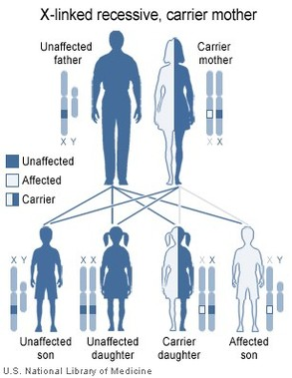
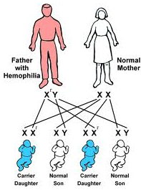
Shared Gene Expression
Some traits are linked to the sex chromosomes
Balding

Slide 49
Inheritance
How can two green plants produce a yellow plant?

Slide 50
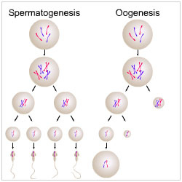
Mutations
What is a mutation?
Any change in the normal DNA sequence
Only mutations that occur in the sex cells (egg and sperm ) can be passed onto the next generation
Called germ cell mutations

Slide 51
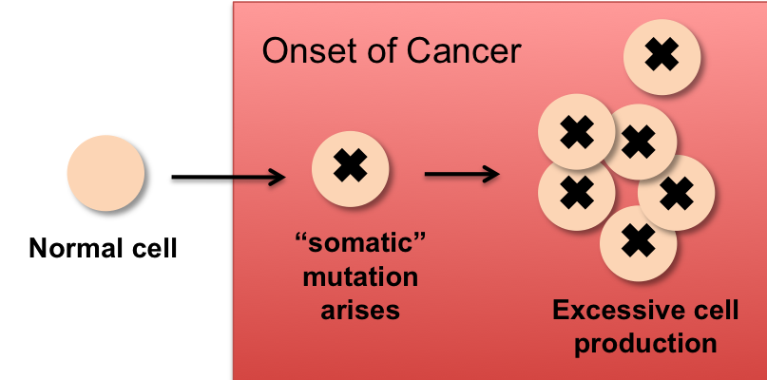
Mutations
Mutations that occur in the body and that are passed onto the daughter cells during mitosis are somatic cell mutations
Two classifications of mutations are chromosome and gene

Slide 52
Chromosome Mutations
Chromosomes mutations occur during cell division when the DNA is being shuffled and result in structural change to the DNA or deletion of an entire chromosome.
4 major types of mutations occur during cell division
Translocation, Deletion, Inversion, Non-disjunction

Slide 53
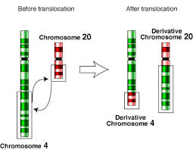
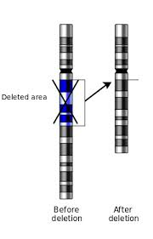
Chromosome Mutations
Translocation – when a piece of DNA breaks away from one chromosomes and attaches to a different chromosome
Deletion – when a piece of , or an entire chromosome is lost or is not replicated

Slide 54
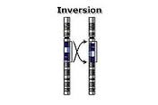
Chromosome Mutations
Inversion – when a piece of DNA breaks away and then reattaches in the opposite direction
Non-disjunction or non-separation – when a chromosome fails to split apart during cell division, resulting in an extra chromosome in one cell and one less in the other daughter cell

Slide 55
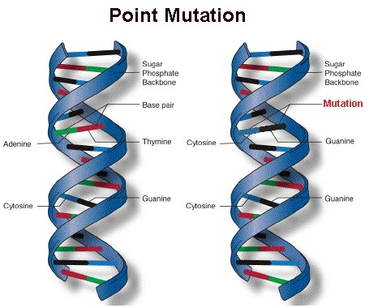
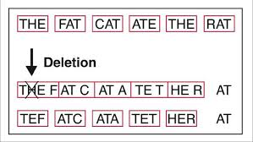
Genetic Mutations
Gene mutations
Smaller scale than a chromosome mutation
It may involve a single nitrogen base or a larger piece of DNA
Point mutation
When a single nitrogen base is added, substituted, or removed
Any of these three changes of a gene result in a different protein structure
Why?
Addition or deletion causes the code to be shifted up or down – similar to hitting the space bar or backspace on the computer
Called a frame-shift mutation

Slide 56
Cause of Mutations
Mutagens- any environmental factor that can damage DNA
Increased amounts of energy or chemicals that interfere with the process of DNA replication can cause mutations
Radiation
Sunlight – ultra-violet radiation
Atomic bombs – gamma radiation
asbestos, radon gas – alpha and beta radiation
All energy

Slide 57
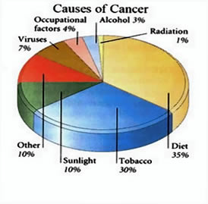
Causes of Mutations
Other agents
Cigarette smoke
Certain viruses
Chemicals in food
Carcinogen – anything that causes or is linked to the cause of cancer
Cancer is related to:
Inherited genes – some people are more likely to get cancer because of their genetic make-up
Frequency of exposure and the intensity of the exposure to cancer causing agents (up the odds)
Infection by virus that inhibit the normal process of DNA replication or cell division

Slide 58
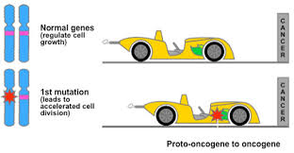
Causes of Mutations
All of these affect the process of cell division, either genetically or functionally
Oncogene – gene that when affected can cause a cell to become cancerous
Cancer is a cell or group of cells that are out of control in terms of cell division
Cancer cells do not have natural stops for cell division

Slide 59
Types of Cancer
Results in tumors – abnormal masses
Benign – do not spread
Malignant – break away from the original mass and spread

Slide 60
Types of Cancer
Three classifications of cancer
Lymphoma – solid tumors in blood cell producing tissues

Slide 61
Types of Cancer
Leukemia – affect white blood cells

Slide 62
Types of Cancer
Carcinoma – skin and nervous tissue

Slide 63
Blood Type

Slide 64
Blood Type
Positive and negative blood types work in the same fashion
Positive has a protein names after the rhesus monkey and cannot donate to people with a negative blood type

Slide 65
Blood Types
History of blood use and beliefs
Universal donor = Can give blood to anyone
Universal recipients = Can receive blood from anyone

