Slide 1
Homeostasis in Organisms

Slide 2
Overview
Anything that is living must maintain homeostasis
The inside of anything that is living must keep stable and balanced
There is a narrow range of internal balance
Body temperature must remain around 98.6°F or 37°C
If you become too hot or too cold, you lose your internal balance and your biological processes will start to fail

Slide 3
Basic Biochemical Processes of Living Organisms
Biological Processes = processes that occur within living things
Everything needs energy and “raw materials,” like atoms and molecules.
Two of the main biochemical processes are photosynthesis and respiration

Slide 4
Basic Biochemical Processes of Living Organisms
Photosynthesis = process by which energy is stored in bonds of organic molecules, like carbohydrates
Plants, algae, any many single-celled organisms carry out photosynthesis
Respiration = chemical energy that is stored in nutrients is released for use in cells.
All living things carry out respiration

Slide 5
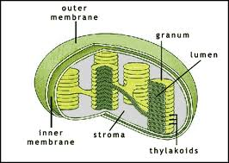
Storing Energy: Photosynthesis
Energy for life comes primarily from the sun.
Energy from the sun is necessary for there is be energy to be released in living things.
Things that carry out photosynthesis contain light-capturing molecules
They are found in the chloroplasts (green colored organelles in plants)

Slide 6
Chloroplasts
The chlorophyll is held within the thylakoid
Chlorophyll molecules are pigment molecules that absorb and reflect certain wavelengths of light energy

Slide 7
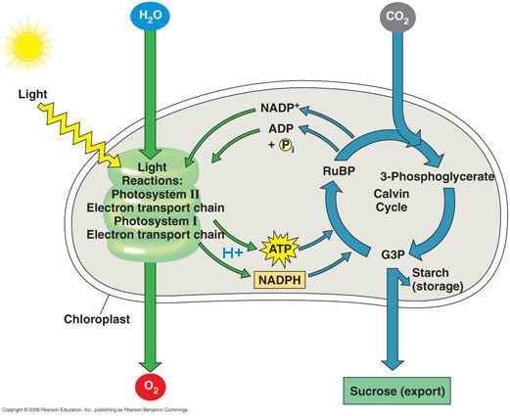

Slide 8
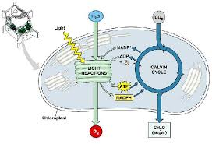
How Light is captured
Photosynthesis happens in steps
The first two steps are “light reactions”
They require light
The third step is a “dark reaction”
Also called the Calvin Cycle and does not require light
It can occur with or without light
https://www.youtube.com/watch?v=pE82qtKSSH4

Slide 9
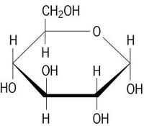
Storing Energy: Photosynthesis
Organisms that conduct photosynthesis convert inorganic molecules (carbon dioxide and water) into energy-rich organic molecules.
One of the most important organic molecules is glucose
Glucose = a simple carbohydrate
Oxygen gas is also released

Slide 10
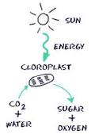
Storing Energy: Photosynthesis
Light energy + water + carbon dioxide ➔ glucose + oxygen
Light + 6H₂O + 6 CO₂ ➔ C₆H₁₂O₆ + 6 O₂

Slide 11
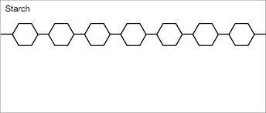
What happens to the Sugar produced by Photosynthesis?
Plants use the glucose made by photosynthesis in two ways
It is mainly used to generate ATP molecules during cellular respiration
Cellular respiration = process that releases energy from chemical bonds
Glucose can also be used as a raw material to build other molecules

Slide 12
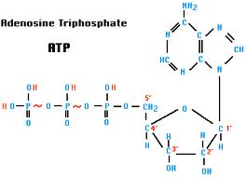
Using Glucose to make ATP
Glucose can be made into ATP, a high energy molecule
The bonds that form ATP can be broken to release a lot of energy
They are broken during cellular respiration
Many cellular processes “run” on ATP not glucose so having ATP is essential

Slide 13
Complex Molecules and Their Functions
Molecule | Function
ATP | Supplies energy for cells to run on
DNA | Carries hereditary information
Carbohydrates | Acts as a food reserve molecule
Lipids (fats and oils) | Acts as a food reserve molecule
Protein | Makes up enzymes and many cell parts

Slide 14
Using Glucose to Build Complex Molecules
Cells can use glucose as a building block for synthesis
Plants store a lot of glucose as starches
When we eat plants we digest the starches and decompose (break down) into glucose again
We can use it for energy right away or store it again as fat.

Slide 15
Summary of Photosynthesis
Energy | Comes from sunlight (solar energy) and ends up as glucose (chemical bond energy)
Materials Used | CO₂ gas and water are used
Materials Produced | Molecules made from CO₂ and H₂O = Sugar (glucose), Oxygen gas,
Time Frame | When light is available, daytime
Location | Occurs in the chloroplasts of plant cells, algae, and some single-celled organisms
Importance of Photosynthesis | To either 1) use glucose to synthesize other molecules 2) break down the glucose to release stored energy
Relationship to Respiration | Energy stored in glucose during photosynthesis is transferred to the chemical bonds of ATP. Everything ”runs” on ATP

Slide 16
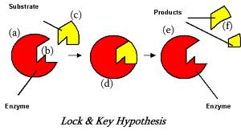
Releasing Energy: Cell Respiration
Everything needs energy.
Needs to break bonds in chemical to get the energy
Digestion
A series of chemical reactions digests glucose with enzymes
Enzymes = special proteins that affect the rate of reactions
Cellular respiration = the process of releasing the energy in chemical bonds

Slide 17
Releasing Energy: Cell Respiration
Cellular respiration requires oxygen
Obtained from the environment
Release carbon dioxide
This is gas exchange
Cells capture the energy that is released from glucose
That energy is then used to make ATP

Slide 18
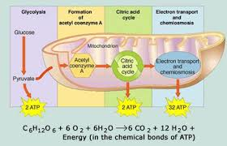
Releasing Energy: Cell Respiration
Cellular respiration is completed in the mitochondria
Cells that require a lot of energy require more mitochondria
Muscle cells have more mitochondria than skin cells
Mitochondria release CO₂ and H₂O
Most cell processes use ATP directly for energy

Slide 19
Cell Respiration and Photosynthesis
The chemical equation for photosynthesis:
The chemical equation for cellular respiration:
Two types of respiration:
Aerobic and anaerobic respiration

Slide 20
Two Types
Both types start with glycolysis:
Glucose molecules are broken down into 2 pyruvic acid molecules
Does not require oxygen
Enzymes catalyze the 4 stages of glycolysis
Anaerobic respiration – fermentation
Pyruvic acid molecule is broken down further without the use of oxygen
Aerobic respiration
Pyruvic acid molecule is broken down using oxygen
Most organisms are able to accomplish this
Far more energy is produced through aerobic respiration

Slide 21
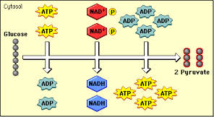
Stages of Respiration
Stage 1: Glycolysis
Occurs in cytoplasm
Does not require oxygen – anaerobic
A glucose molecule goes through 10 chemical reactions to form 2 pyruvic acid molecules and a net gain of 2 ATP molecules
There is a gross of 4 ATP produced, but 2 ATP molecules are needed to supply the activation energy 4 ATP – 2 ATP = 2 ATP

Slide 22
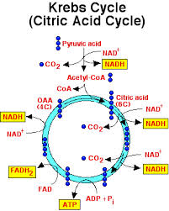
Stages of Respiration
Stage 2: Kreb’s Cycle
Occurs in the mitochondria
The “workbench” that has all of the necessary “tools” (enzymes)
It is set up like an assembly line for efficiency
Requires oxygen – aerobic
In a “nut shell”
Pyruvic acid is totally dismantled into a pile of carbon, hydrogen, and oxygen atoms
The carbon and oxygen atoms combine to form CO2 which is then exhaled
The H atoms are delivered to stage 3

Slide 23
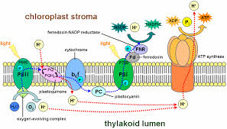
Stage of Respiration
Stage 3: Electron Transport Chain
Hydrogen dissociated (breaks apart) into a proton H+ which “hangs out” and an electron which gets passed like a hot potato along a series of molecules and as it is passed it released some energy which is used to create ATP molecules
The electron rejoins the H+
Then the H combines with oxygen to form water
https://www.youtube.com/watch?v=-Gb2EzF_XqA

Slide 24
Summary of Cell Respiration
Energy | Comes from chemical bond energy of glucose, ends up in the bonds of ATP where it use used throughout the cell
Materials Used | Sugar and other energy-rich organic compounds and oxygen; food is obtained through photosynthesis in producers then eaten by consumers Oxygen is obtained through gas exchange
Materials produced | ATP and 2 waste products (CO₂ and H₂O) CO₂ is released in gas exchange
Time Frame | Cell respiration occurs in all cells 24 hours a day
Location | Respiration occurs in cells of al living things, in most organisms it is conducted in mitochondria
Importance of Respiration | All cells “run” on energy released from ATP. ATP can be used for just about anything within the cell. It is essential for metabolic processes

Slide 25
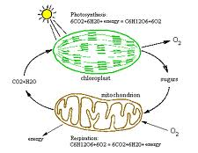

Slide 26
Oxygen
Oxygen is so vital because it keeps the bottom of the electron transport chain clear of H atoms. If H is not cleared away, stage three stops = no more ATP
ATP from glycolysis will last only about 1 minute before it is used up and cannot keep up with the body’s need
This is the reason that you die without oxygen

Slide 27
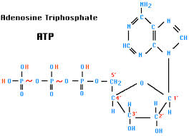
ATP
Adenosine triphosphate
Energy storage molecule
Energy is stored in bonds between the phosphates

Slide 28
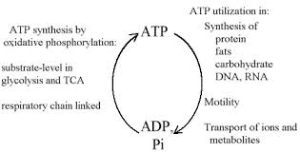
ATP Cycle
ATP is not completely destroyed when it is used, instead it is broken down to release the energy in the bonds but is then rebuilt later

Slide 29
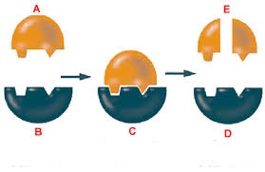
Enzymes
Catalyst = substance that speeds up the rate of a chemical reaction
It is never changed or used up, so it can be used over and over again
Enzymes = protein catalysts
Speed up reactions in cells

Slide 30
Function of Enzymes
Biochemical process (digestion, synthesis, respiration, photosynthesis) use enzymes
Enzymes interact with other molecules when collide
Enzymes regulate reactions in the body
Need normal body temperature to function

Slide 31
Importance of Molecular Shape
Enzymes, hormones, antibodies, and receptor molecules have specific shapes
These determine how they function and interact with other molecules
Many enzymes only interact with specific molecules
Enzymes can fit together with other molecules like a “lock and key”
If the shape is altered it may no longer interact with molecules or function properly.

Slide 32
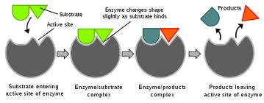
Enzyme Reaction Rates
Enzymes have a very specific shape, temperature, and pH that need to either speed up or slow down a reaction

Slide 33
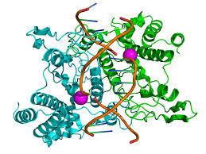
Shape
Enzymes are chain-like proteins that are folded into a precise shape
Each enzyme has a special shape
If the shape changes it will not function correctly
High temperatures or pH changes can cause the enzyme to change its shape either temporarily or permanently
For each enzyme that is altered the reaction rate will be effected in proportion to the number of enzymes effected

Slide 34
Temerpature
Most enzymes have an optimum temperature when they work their best.
For humans it will most likely be body temperature (98.6°F or 37°C)
As an enzyme reaches it’s optimum temperature, enzymes will interact more efficiently
With proper orientation and energy
As temperatures increase or decrease enzymes lose their effectiveness

Slide 35
pH
pH is a scale that measures how acidic, neutral, or basic a substance is
Different pH will effect enzymes similarly to temperature
Most enzymes work best at a pH of 7.
pH of 7 is neutral = like water
Some enzymes like specific acid or base pH’s
Stomach enzymes like acidic pH’s of 2 or 3
Small intestine enzymes like a pH of 8
Enzymes have an optimum pH (like optimum temperature)

Slide 36
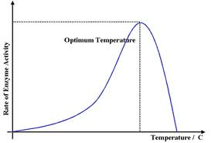
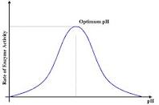

Slide 37
Feedback and Homeostasis
An organisms external and internal environment are always changing
Living things must constantly monitor the environment
Stability is reached when organisms detect deviations (changes) in the environment and respond with a corrective action
This will return the organisms balance
If an organisms monitoring and control systems fail, then disease or death could result

Slide 38
Responses to Environmental Change
Organism | Change (Stimulus) | Response
Species of bacterium | Temperature falls below a certain temperature | Bacterium produces a chemical that acts as an antifreeze
Many Plants | Air too hot and dry | Leaf pores close to conserve water
Monarch Butterflies | Seasons change | Butterflies migrate
Human | Person hears a loud noise | The person becomes alter; heart rate increase for “flight or flight”

Slide 39
Dynamic Equilibrium
Organisms have a variety of mechanisms that maintain the physical and chemical aspects of the internal environment within a narrow limit to allows for cell activity
Homeostasis is the result
Homeostasis = “steady state”
Some scientist don’t like the phrase steady state because they think it means unchanging
Dynamic equilibrium is the preferred statement
Dynamic equilibrium = constant small corrections that keep the internal environment within limits needed for survival

Slide 40
Dynamic Equilibirum
Microorganisms or diseases can interfere with dynamic equilibrium
Organisms develop mechanisms to deal with these changes in equilibrium.
They are not fool-proof however
The balancing mechanisms have limits as well.

Slide 41
Feedback Mechanisms
Feedback mechanism = cycle where the output of a system “feeds back” to either modify or reinforce the action taken by the system
There are many feedback systems that help organisms respond to “stimuli”
Stimuli = changes in the environment
Multi-celled organism detect and respond to change on both a cellular level and an organism level

Slide 42
Feedback Mechanisms
Feedback responses can be simple or complex
Simple feedback may be a hormone that regulate a chemical process
Complex feedback can be an elaborate behavior

Slide 43
Feedback Mechanisms
Feedback can be positive or negative
Positive feedback = a change that leads to a greater change and a greater response
Negative feedback = a change that leads to less of a change and a lessened response

Slide 44
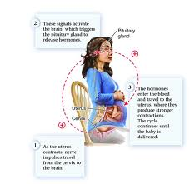
Positive Feedback
Change that promotes a greater change and response
Childbirth is an example
Contractions push the baby down and against the uterus
These cause stronger contractions pushing the baby harder against the walls of the organ
Causing stronger contractions and so on

Slide 45
Negative Feedback
The most common feedback systems
Sometimes the change causes system 1 to send a message to system 2 which responds by attempting to restore homeostasis
Once the second system responds, the first system stops signaling for the change

Slide 46
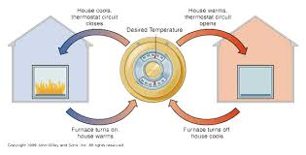
Negative Feedback
House heating system
The thermostat is set at a particular temperature
When the room cools below that temperature, the thermostat sends a message to the furnace that then turns on
When the room temperature rises above the temperature the thermostat stops sending the message to the furnace which causes it to turn off

Slide 47
Negative Feedback
A similar system occurs in the human body
Within the brain a structure detects the temperature of the blood is low.
This structure sends a message to the muscles, causing them to contract and relax in rapid cycles (shiver)
This generates body heat
When the body temperature has increased the sensors in the brain detect the change and stop sending the signal

Slide 48
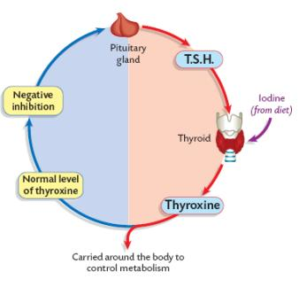
Negative Feedback and Cell/Organ System Interaction
Maintaining dynamic equilibrium means there must be interactions between cells, organs, and systems
Cells have to monitor the amount of glucose in the blood
When glucose is above normal levels, the pancreas secretes insulin
Insulin is the hormone that prompts glucose to move from the blood into cells
This lowers the glucose levels in the blood
There is another hormone secreted by the pancreas that does the opposite
Releases glucose stored in the liver

Slide 49
Feedback System for Glucose
Sensor detects high blood sugar level
Pancreas secretes insulin
Blood sugar level drops
Negative feedback: lowered blood sugar leads to shutting off of insulin production

Slide 50
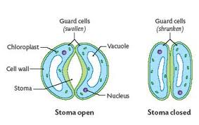
Negative Feedback and Cell/Organ System Interaction
Increase muscle activity is often accompanied by an increase in heart rate and breathing rate
If it didn’t, we wouldn’t get another oxygen to the muscles to keep working
When plants have a shortage of water, guard cells, cells that surround pores on the leaf, change shape to close the pores and reduce evaporation

Slide 51
Disease as a Failure of Homeostasis
Disease = any condition that prevents the body from working as it should
The body can fail to maintain homeostasis due to disease
Diseases can come from invaders into the body = pathogens
Disease can come from abnormal cells in the body, which could lead to cancer
Disease can come from toxic substances, poor nutrition, organ malfunction, inherited disorders, risky behaviors

Slide 52
Disease as a Failure of Homeostasis
Sometimes a disease is recognizable right away
Example: birth defects and poisoning
Sometimes a disease may not show up for years
Example: Lung cancer caused by tobacco smoke

Slide 53
Causes of Disease
Cause of Disease | Examples
Inherited Disorders | Down Syndrome, Cystic fibrosis, sickle cell disease
Exposure to Toxins | Lead poisoning, radiation poisoning
Poor Nutrition | Scurvy (vitamin C deficiency), goiter (iodine deficiency)
Organ malfunction | Heart attack, diabetes
High-Risk behaviors | Lung cancer, drug addiction, skin cancer

Slide 54
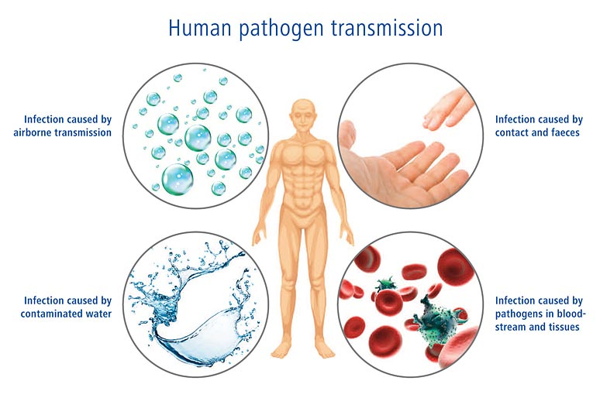
Pathogens
There are many disease-causing organisms in the air, water, food we take in every day
Pathogens = virus, bacteria, fungi, and parasites
They interfere with normal functioning and can make us seriously ill
Plants and animals can be influenced by similar organisms

Slide 55
Pathogens and Disease
Pathogens | Description of Pathogen | Examples of Disease
Virus | Particles composed of nucleic acid and protein. Reproduce when the invade living cells | Examples include the common cold, influenza, AIDS, and chicken pox. Immunizations have been developed to combat many viral diseases
Bacterium | One-celled organisms | Bacterial illnesses include strep throat, syphilis, and food poisoning. Antibiotics, drugs like penicillin that we get from microorganisms are used to treat many bacterial diseases.
Fungus | Fungi are organisms made of either one or many cells. They include yeasts and molds. They eat by absorbing organic substances | Examples include athlete’s foot and ringworm. Fungicides and antibiotics are used to fight fungal diseases
Parasites | Some animals and one-celled organisms are parasites that survive by living and feed on other organisms | Parasites include leeches and tapeworms. Malaria is a disease caused by a one-celled organism. It is transmitted to humans by mosquitoes. Heartworm is a parasitic worm that lives in dogs and cats. Medicines are available to treat some parasitic diseases. Avoiding exposure to the parasite is also effective

Slide 56
Cancer
Genetic mutations in a cell can result in uncontrolled cell division = cancer
Cells exposed to certain chemicals and radiation increases mutations and increases the chance of cancer
Genes control and coordinate a cell’s normal cycle of growth and divisions are altered by mutation
The cell begins to divide abnormally and uncontrollably
Mass abnormal cells are referred to as a tumor

Slide 57
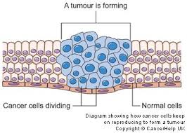
Cancer
Abnormal proteins on the surface of the cell can give them away
Once these proteins are identified, the immune system can attack and destroy
If the immune system can not destroy the cancer cells, then the disease will become life-threatening

Slide 58
The Immune System
Humans have ways of protecting themselves from danger and disease
Eyes, ears, and nose help to sense danger
Release hormones that stimulate emergency responses to danger
Muscles help us fight off some threats and to flee from others
Skin keeps out many foreign organisms that could be harmful
Tears, saliva, and other secretions trap and/or destroy invaders that come into contact with them
Nervous system provides rapid coordination of many of our responses to danger

Slide 59
The Immune System
The body needs effective ways to combat invaders (or cells that malfunction)
The immune system is the body’s defense against disease-causing pathogens
Most threats can be detected by molecules on their outer surface/membrane
These molecules, antigens, trigger a response from the immune system
Toxins (poisons) can also act as an antigen

Slide 60
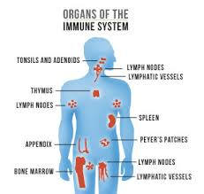
The Immune System
All cells have potential antigens on their surfaces
The immune system can usually tell “self” cells apart from “non-self” cells
When an antigen has been recognized, the white blood cells and antibodies attack them and the cells that display them

Slide 61
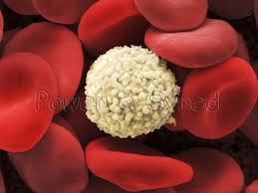
White Blood Cells and Antibodies
Some white blood cells (WBC) are specialized to surround and engulf (eat) invading pathogens
Other WBC produce antibodies
Antibodies = proteins that either attack the invaders or mark them for killing
The cells that are marked by antibodies will be destroyed by other WBC’s

Slide 62
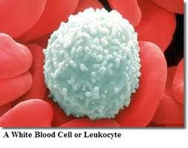
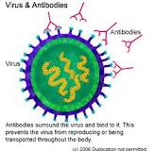
Antibodies and WBC Image

Slide 63
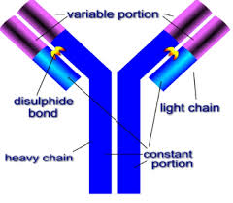
White Blood Cells and Antibodies
Most of the antibodies and WBCs that attack invaders break down soon after
Some of the WBCs will remain
These cells quickly divide and produce more antibodies of the same kind to fight off later invasions of microbes
Microbes = microscopic organisms
Antibodies are effective for years

Slide 64
Vaccinations
Scientists have discovered that weakened microbes or parts of microbes can stimulate the immune system
The antigens found on the live microbe is usually the same as the antigens found on weakened or killed microbes
Vaccines use weakened or killed microbes to stimulate the immune system into creating antibodies to fight the microbe

Slide 65
Vaccinations
After the vaccine is given the immune system “remembers” the pathogen
It as if the WBCs have actually attacked a live pathogen and antibodies are created
If the person actually contracts the pathogen in live form, the immune response is quick and will hopefully will not even have time to develop before the immune system wipes it out

Slide 66
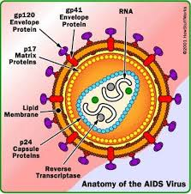
Damage to the Immune System
A person’s immune system can be weakened by many factors
Age, stress, fatigue, AIDS
AIDS is a viral disease that attacks the immune system
A person with AIDS is left unable to fight infections and cancerous cells

Slide 67
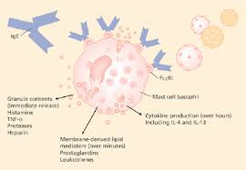
Problems Associated with the Immune Response
Sometimes the immune system can cause problems
Allergies = a rapid immune system reaction to environmental substances that are normally harmless
Types of allergies = food, pollen, chemical

Slide 68
Problems Associated with the Immune Response
People with allergies, the immune system releases histamines
This can lead to: running nose, sneezing, rash, swelling
Swelling can be dangerous because it can interfere with breathing
People with allergies often take antihistamines to reduce the effect of the histamines and symptoms caused by them

Slide 69
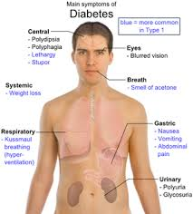
Problems Associated with the Immune Response
Sometimes the body does not recognize cells as “self” and attacks them
If the body attacks the pancreas cells that produce insulin, diabetes can result

Slide 70
Problems Associated with the Immune Response
Transplants of organs create an issue.
The organ of another individual can be recognized as “non-self” and attacked as well.
If the body attacks the organ the transplant would have been useless, the body will kill the organ, called rejection
To avoid rejection the person is given injections of special drugs to reduce the effectiveness of the immune system
The person is no longer good at fighting off disease, can become ill easily

Slide 71
Preparation and use of a vaccine
Obtain pathogen
Treat pathogen to kill or weaken it.
Inject altered pathogen (vaccine) into organism.
Body responds to antigens present by making antibodies and having WBCs attack invaders
Some WBCs specific for this pathogen remain in the body for a long time to continue the protection from future attacks by the pathogen.

Slide 72
Research and Progress Against Disease
Researching diseases and how they effect us has led to knowledge on how to diagnose, prevent, control, and cure diseases

Slide 73
Biological Research of Diseases
Category of Research | Methods Developed
Diagnosing Disease | -Culturing (growing) bacteria from the infected person to determine what pathogen is responsible -Use X-rays, CAT scans, Ultrasound, blood pressure devices, & other detection methods. -Detect genetic abnormalities that may be present.
Preventing and Controlling Disease | -Promoting sanitation, (washing hands), garage disposal, sewage treatment. -Sterilizing surgical equipment, treating wounds. -controlling populations of disease carrying organisms. -Treating milk, water, and other foods to reduce pathogens -Vaccinating to promote immunity -Identifying the dangers of risky behavior
Treating and Curing Disease | -Developing antibiotics and other drugs to kill pathogens -Developing medical procedures to remove damaged and diseased tissue from the body.

