Slide 1
Laboratory Skills and Scientific Inquiry and Skills

Slide 2
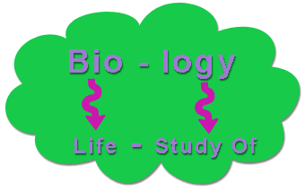
Biology
Biology is all about trying to understand the world that we live in
To understand we need to observe and experiment
To do this, we need tools and techniques

Slide 3
Metric System
Base units are:
Meter, liter, gram, cubic centimeter, second, degree Celsius
Create the scale:

Slide 5
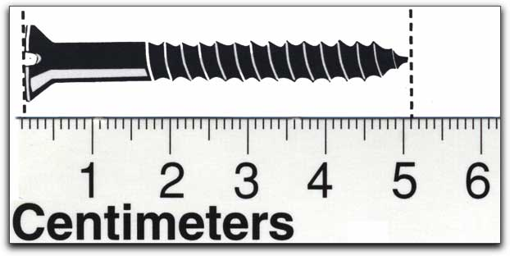
Conversions
Example:
Length in cm
Length in mm
Length in m
Length in μm

Slide 6
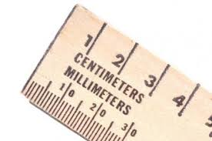
Tools
Metric Ruler
Used for length measurement
Centimeters or Millimeters
Micrometers for microscopic organisms

Slide 7
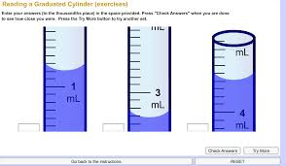
Tools
Graduated cylinder
Used to measure volume
Liters or Milliliters
Always measure from the bottom of the meniscus

Slide 8
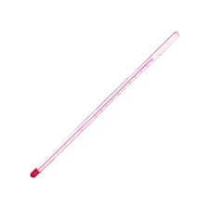
Tools
Thermometer
Used to measure temperature
Measured in degrees Celsius
Freezing point of water is_______
Boiling point of water is _________
Human body temperature is _________

Slide 9
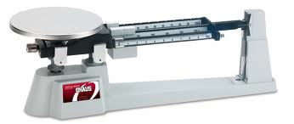
Tools
Balance
Used to measure mass (quantity of matter in something)
Could use an electric balance or a triple beam balance
Balances have to be zero’ed, clean and protected

Slide 10
Dichotomous Keys
Tool used to sort, name and/or classify a particular organism
Series of steps that typically have two steps that either identify an organism or leads to another set of steps that can.
The key must separate organisms into groups to work properly

Slide 11
Dichotomous key
1A. Organism is prokaryotic-------Kingdom Monera
1B. Organism is eukaryotic-------go to 2
2A. Organism is unicellular or colonial----kingdom Protista
2B. Organism is multicellular-------go to 3
3A. Organism is autotrophic-----Kingdom Plantae
3B. Organism is heterotrophic-------go to 4
4A. Organism absorbs nutrients-------Kingdom Fungi
4B. Organism ingest nutrients -------Kingdom Animalia

Slide 12
Create your own Dichotomous Key

Slide 13
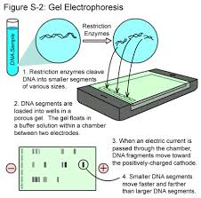
Electrophoresis
Gel electrophoresis
Allows molecules to be separated based on size
DNA and Proteins
Separation based on charge
Wells are made in a gel, the sample is placed in the wells
The gel is placed between positive and negative charges
Move toward opposite charges
Smaller move farther
Can compare results to find similar organisms

Slide 14
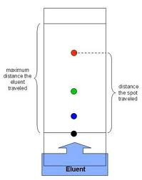
Chromatography
Used to separate mixtures of molecules
There are different types of chromatography:
Paper chromatography: a mixture is placed on a paper, the tip of the paper is then placed in a solvent (solution that can dissolve the mixture). The solvent travels up the paper, dissolving the mixture and separating it into its components along the way. Components move based on how well they are attracted to the paper or solvent.
Liquid and Gas chromatography

Slide 15
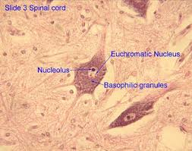
Stains and Indicators
Stains are used to make cell structures more visible
Commonly use iodine or methylene blue
Can be used to identify parts of a cell or differences between cell types
An indicator is a substance that changes color when it contacts certain chemicals.
pH paper is used to test the acidic or basic levels
Iodine (lugol’s) solution changes from golden brown to blue-black in the presence of starch

Slide 16
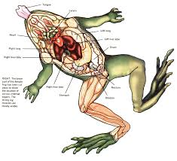
Observing Plant and Animal Specimens
Observations are the key to understanding biology and the living environment.
Dissection is a tool we can use to understand how organisms work

Slide 17
Dissection and Preserved Specimens
Dissection is the examination of preserved specimens, provides a way to:
Observe similarities and differences that exist among species
Understand the relationship between form and function
Expose and identify the internal structures of organisms
To dissect we need to know what equipment to use and how to use it properly as well as a clean and organized work area

Slide 18
Dissection Equipment
Equipment | Use
Dissection pan | Similar to cake pan but with wax or rubber on the bottom. The specimen is placed within the pan
Dissecting pins | Large “T” pins used to anchor the specimen to dissection pan
Scalpel | Sharp instrument used to open specimen
Scissors | Used for cutting open or removing parts of specimen. May have two sharp points or one sharp and one blunt point
Probe/Teasing needle/Dissecting needle | Used to move, lift, point out, or gently pull apart organs or structures.
Tweezers/Forceps | Used to lift, move or pry part objects.
Safety goggles | Protect eyes from accidental splashes

Slide 19
Scientific Inquiry
Use evidence to support ideas
Earth is flat -----Earth is round
To investigate scientifically
Question!
Observe and Infer
Experiment
Collect and organize data
Find evidence and draw conclusions
Repeat the experiment many times
Review with peers

Slide 20
Observe and Infer
Observations are things or events made using the five senses or tools
Inference = Conclusions or ideas based on observations
Assumptions = belief that something is true
Opinion = ideas that may or may not have any basis in fact
Can be biased – Leave out of data collection and analysis

Slide 21
Scientific Method
After you have asked questions…
Research
Find background info
Develop a hypothesis
Design your experiment to test that hypothesis

Slide 22
Scientific Method
Series of steps to create a good experiment
1. what is the question or problem
2. formulate a hypothesis
3. design and conduct a controlled experiment. What is the independent variable in this experiment?
4. Make observations and collect data. What I the dependent variable in this experiment
5. Analyze data
6. Draw conclusions. Accept or refute hypothesis
7. Report findings for per review.

Slide 23
Scientific Method
A good hypothesis has an independent and a dependent variable.
Independent = cause.
The single factor that the scientist is testing. What the experimental group will receive that the control does not.
Dependent = effect
What is measured and observed. What is affected by the independent variable.
Experiments cannot prove a hypothesis but only support it or fail to support it.
“I think that…”

Slide 24
Scientific Method
Each experiment needs an experimental group.
This is the group that will test the cause and effect relationship between the hypothesis.
The control group will be a point of reference to compare the experimental group to.
It gets “normal conditions”
Everything else must stay the same
Can only test one variable!

Slide 25
Collecting and Organizing Data
Data is what is collected as results from experiments.
It can be organized into diagrams, tables, charts, graphs, and equations.
We must then use the data to make inferences, predictions, and conclusions

Slide 26
Scientific Method
Things to include within the conclusion:
Does the data agree with or disagree with the original hypothesis?
Statement of what the data tells us
How can this experiment be more valid?
Why might other scientists want to conduct this experiment?
Results must be reported and must be able to be repeated by others
Peer review

Slide 27
Graphing
Graphs are useful for analyzing data.
Line Graph
Used to show the relationship between two variables. Independent variable is place along the X-axis and the dependent variable is placed on the Y-axis.
All graphs need a title, all axis must be labeled with units, the appropriate scale on the axis must be equal intervals, always plot the data point, draw a circle around them, and connect the consecutive points.

Slide 28
Line Graph Example
Amount of rain (inches) | Amount of grain produced (bushels/acre)
7 | 50
9 | 60
10 | 65
11 | 70
12 | 65
13 | 60
15 | 20

Slide 29
Pie Chart
Pie charts show parts of wholes or percentages
Create your own pie chart: How many hours per day to you spend doing the following:
Sleeping______ Playing_____
Watching TV______ Eating______
In Class________ Other______

Slide 30
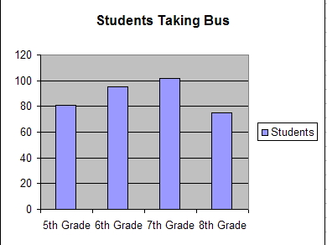
Bar Graph or Histogram
Bar graphs or histogram also represent the relationship between two variables.
The x and y-axis are similar to line graphs.

Slide 31
Laboratory Safety
We need to know how to properly use safety equipment in the lab area
Safety equipment: fire extinguisher, safety shower, eye wash station, fire blanket, emergency gas shutoff
Goggles, aprons, gloves

Slide 32
Safety guidelines
Read all directions before starting
Questions? Ask!
Don’t do anything without permission
No eating or drinking
When heating, slant test tubes away from others and never heat a closed container
Never inhale or taste chemicals or objects
If spills, wash off skin immediately and tell me.
Tell your teacher if you get hurt
Tie back hair, secure loose clothing

Slide 33
Safety Guidelines
Know the properties of chemicals you are using
Know what equipment to use
Don’t use damaged equipment
Never pour chemicals back into original bottles or switch equipment between chemicals
Use the proper equipment
Always clean up your space, turn off gas and water and disconnect electrical devices
Dispose of chemicals according to instructions
Wash your hands!

Slide 34
Microscope Skills
Microscope is made of lens to make objects easier to see
Magnification makes the objects appear bigger
Stereoscopes (dissecting microscopes)
Two ocular eyepiece lenses
Magnification is low, image is in 3-D and not reversed
Compound light microscope
One ocular lens
Uses light to see images in eyepiece
Image is magnified by both lens (ocular lens and objective lens)
Total magnification is measured by multiplying the magnification of the eyepiece by the magnification of the objective

Slide 35
Parts of the Microscope
Eyepiece and Ocular Lens
Objective Lenses
Stage
Diaphragm
Light Source
Coarse Adjustment
Fine Adjustment

Slide 36
Using Microscopes
Only clean microscopes with lens paper!
Image will be upside down and backwards
Move the slide in the opposite direction to center the object
Field appears darker with higher magnification
Use the diaphragm to adjust the light
Make sure the object is always in the center of the field of view
When going to higher power the field of view gets smaller

Slide 37
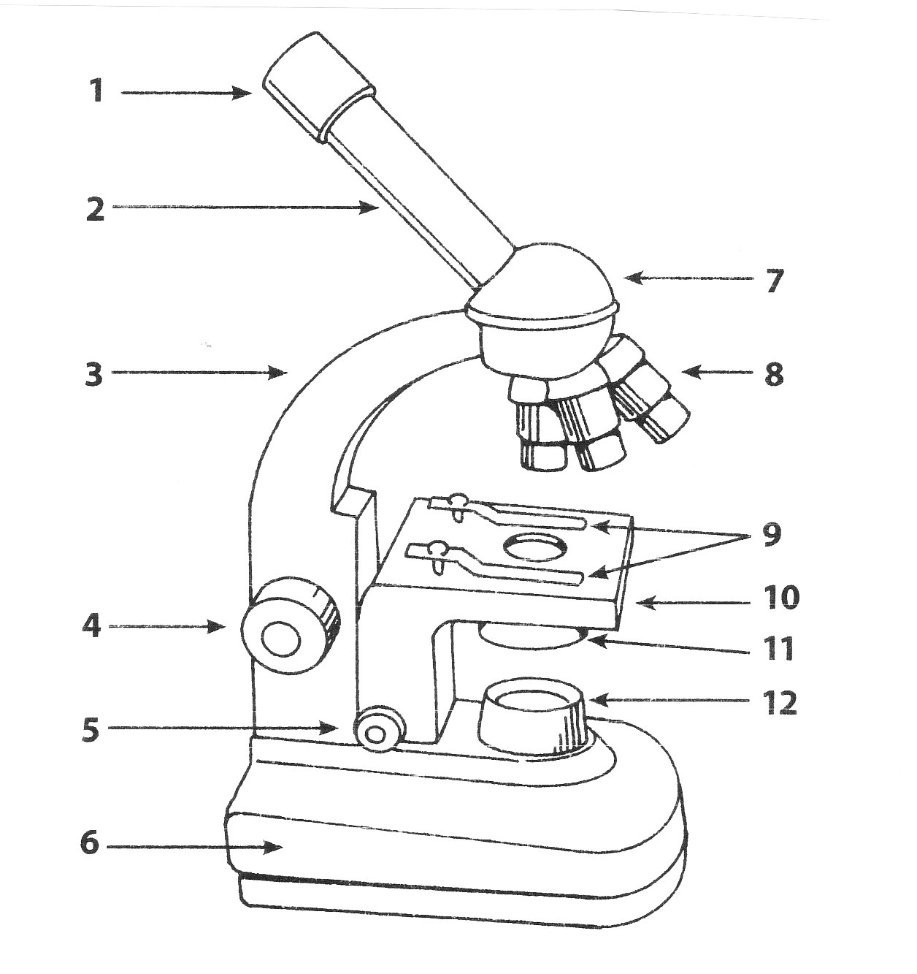

Slide 38
Directions for use

Slide 39
Identifying and Comparing Cell Parts
Nucleus
Round, dense, dark-stained, located anywhere
Cytoplasm
Fills the cell, clear-very grainy, may or may not be visible
Cell membrane
Surrounds cytoplasm, both animal and plant cells
Cell wall
Surround cell membrane in plant cells
Chloroplast
Green, oval, photosynthetic
Mitochondria
Oval, cellular respiration (energy production)
Vacuoles
Often clear areas in cytoplasm, may be specialized
Plants are large and fluid-filled
Chromosomes
Easier to see in cells undergoing division (mitosis and meiosis), Dark stained and thread like, Genetic material

Slide 40
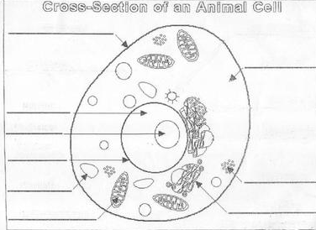

Slide 41
